Slide 1
Path Analysis

Slide 2
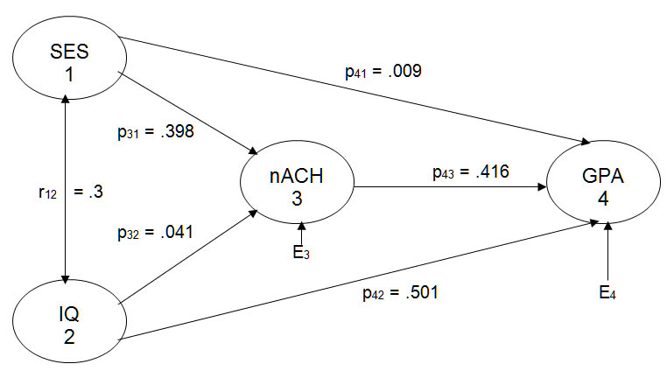
Figure 1

Slide 3
Exogenous Variables
Causally influenced only by variables outside of the model.
SES and IQ in Figure 1.
The two-headed arrow indicates that covariance between SES and IQ may be causal and/or may be due to their sharing common causes.

Slide 4
Endogenous Variables
Are caused by variables in the model
As well as by extraneous variables (E_{i})
Cause is unidirectional.
nAch and GPA in Figure 1.

Slide 5
The Data
 | IQ | nAch | GPA
SES | .300 | .410 | .330
IQ |  | .160 | .570
nAch |  |  | .500

Slide 6
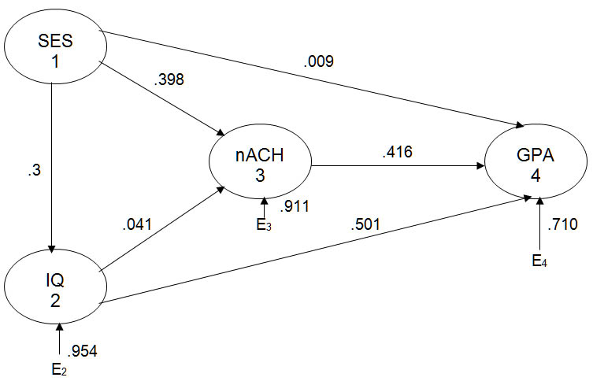
Figure 1A

Slide 7
Path-1.sas
DATA SOL(TYPE=CORR);
INPUT _TYPE_ $ _NAME_ $ SES IQ NACH GPA; cards;
CORR SES 1.000 0.300 0.410 0.330
CORR IQ 0.300 1.000 0.160 0.570
CORR NACH 0.410 0.160 1.000 0.500
CORR GPA 0.330 0.570 0.500 1.000
N . 50 50 50 50

Slide 8
PROC REG;
Figure_1_GPA:
MODEL GPA = SES IQ NACH;
Figure_1_nACH:
MODEL NACH = SES IQ;

Slide 9
Path Coefficients for Predicting GPA
Variable | DF | Parameter Estimate
SES | 1 | 0.00919
IQ | 1 | 0.50066
NACH | 1 | 0.41613

Slide 10
Path Coefficients for Predicting nAch
Variable | DF | Parameter Estimate
SES | 1 | 0.39780
IQ | 1 | 0.04066

Slide 11
Error Coefficients

Slide 12
Decomposing Correlations
the direct effect of X on Y,
the indirect effect of X (through an intervening variable) on Y,
an unanalyzed component due to our not knowing the direction of causation for a path, and
a spurious component due to X and Y each being caused by some third variable or set of variables in the model.

Slide 13
Figure 1

Slide 14
The correlation between SES and IQ, r₁₂
unanalyzed because of the bi‑directional path between the two variables.

Slide 15
The correlation between SES and nAch, r₁₃ = .410
p₃₁, a direct effect, SES to nAch, .398
p₃₂r₁₂, an unanalyzed component, SES to IQ to nAch.041(.3) = .012.
When we sum these two components, .398 + .012, we get the value of the original correlation, .410.

Slide 16
The correlation between IQ and nAch, r₂₃ = .16
p₃₂, the direct effect, = .041
p₃₁r₁₂, an unanalyzed component, IQ to SES to nAch, = .398(.3) = .119
Summing .041 and .119 gives the original correlation, .16

Slide 17
The SES - GPA correlation, r₁₄ = .33
p₄₁, the direct effect, = .009.
p₄₃p₃₁, the indirect effect of SES through nAch to GPA, = .416(.398) = .166.
p₄₂r₁₂, SES to IQ to GPA, is unanalyzed, = .501(.3) = .150.
p₄₃p₃₂r₁₂, SES to IQ to nAch to GPA, is unanalyzed, = .416(.041)(.3) = .005.
When we sum .009, .166, ,150, and .005, we get the original correlation, .33.

Slide 18
The IQ - GPA correlation, r₂₄, =.57
p₄₂, a direct effect, = .501
p₄₃p₃₂, an indirect effect through nAch to GPA, = .416(.041) = .017
p₄₁r₁₂, unanalyzed, IQ to SES to GPA, .009(.3) = .003
p₄₃p₃₁r₁₂, unanalyzed, IQ to SES to nAch to GPA, = .416(.398)(.3) = .050
The original correlation = .501 + .017 + .003 .050 = .57.

Slide 19
The nAch - GPA correlation, r₃₄ = .50
p₄₃, the direct effect, = .416
a spurious component due to nAch and GPA sharing common causes SES and IQ
p₄₁p₃₁, nAch to SES to GPA, = (.009)(.398).
p₄₁r₁₂p₃₂, nAch to IQ to SES to GPA, = (.009)(.3)(.041).
p₄₂p₃₂, nAch to IQ to GPA, = (.501)(.041).
p₄₂r₁₂p₃₁, nAch to SES to IQ to GPA, = (.501)(.3)(.398).

Slide 20
These spurious components sum to .084. Note that in this decomposition elements involving r₁₂ were classified spurious rather than unanalyzed because variables 1 and 2 are common (even though correlated) causes of variables 3 and 4.

Slide 21
Figure 1A

Slide 22
The correlation between SES and nAch, r₁₃ = .410
p₃₁, a direct effect, SES to nAch, .398
p₃₂p₂₁, an indirect effect, SES to IQ to nAch, .041(.3) = .012
The total effect of X on Y equals the sum of X's direct and indirect effects on Y. For SES to nAch, the effect coefficient = .398 + .012 = .410 = r₁₃.

Slide 23
The correlation between IQ and nAch, r₂₃ = .16
p₃₂, the direct effect, = .041 and
p₃₁p₂₁, a spurious component, IQ to SES to nAch, = .398(.3) = .119. Both nAch and IQ are caused by SES, so part of the r₂₃ must be spurious, due to that shared common cause rather than to any effect of IQ upon nAch. This component was unanalyzed in the previous model.

Slide 24
The SES - GPA correlation, r₁₄ =.33
p₄₁, the direct effect, = .009.
p₄₃p₃₁, the indirect effect of SES through nAch to GPA, = .416(.398) = .166.
p₄₂p₂₁, the indirect effect of SES to IQ to GPA, .501(.3) = .150.
p₄₃p₃₂p₂₁, the indirect effect of SES to IQ to nAch to GPA, = .416(.041)(.3) = .005.

Slide 25
The indirect effects of SES on GPA total to .321.
The total effect of SES on GPA = .009 + .321 = .330 = r₁₄.

Slide 26
The IQ - GPA correlation, r₂₄, =.57
p₄₂, a direct effect, = .501.
p₄₃p₃₂, an indirect effect through nAch to GPA, = .416(.041) = .017.
p₄₁p₂₁, spurious, IQ to SES to GPA, .009(.3) = .003 (IQ and GPA share the common cause SES).
p₄₃p₃₁p₁₂, spurious, IQ to SES to nAch to GPA, .416(.398)(.3) = .050 (the common cause also affects GPA through nAch).

Slide 27
The total effect of IQ on GPA = DE + IE = .501 + .017 = .518 = r₂₄ less the spurious component.
The nAch - GPA correlation, r₃₄ = .50, is decomposed in exactly the same way it was in the earlier model.

Slide 28
Just-Identified Models
There is a direct path between each variable and each other variable.
The decomposed correlations will sum to the original correlations without error.
The two following models differ very much but both fit the data perfectly – see the decompositions in the handout.

Slide 29
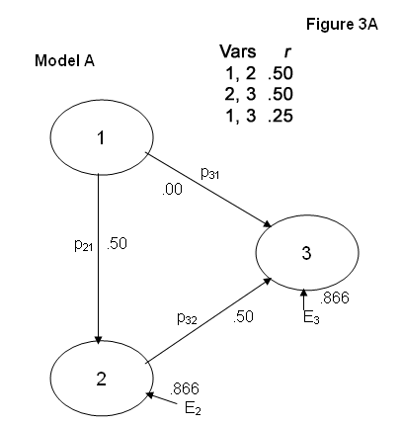

Slide 30
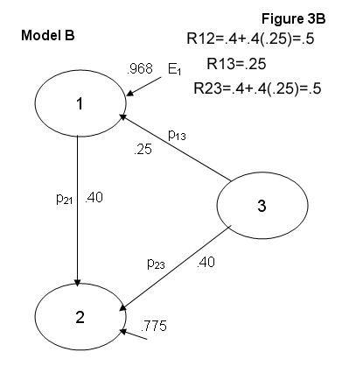

Slide 31
Over-Identified Models
At least one path has been deleted from an otherwise just-identified model.
The model may be able to do a good job at reproducing the original correlations, or it may not.
Each of the following two models fit the data equally well (perfectly).

Slide 32
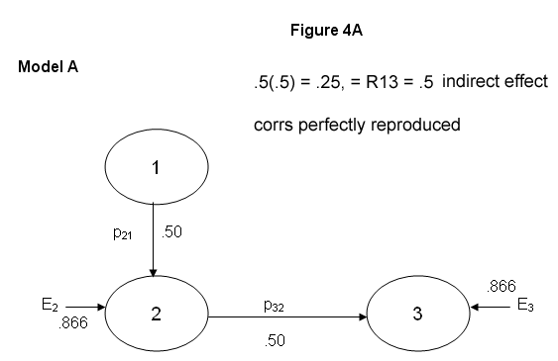

Slide 33
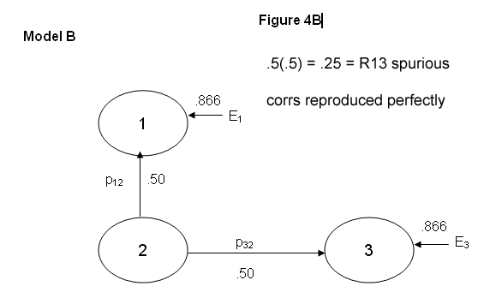

Slide 34
A Poorly Fitting Model
For the model on the following page
r₂₃ decomposes to p₂₁p₁₃ = (.50)(.25) = .125
but the original r₂₃ = .50.

Slide 35
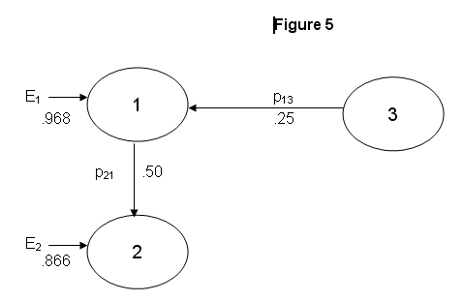

Slide 36
Over-Identified Version of Figure 1
I have dropped two paths from the original Figure 1.
We shall see how well this modified model fits the data.
The reproduced correlations will differ little from the original correlations.

Slide 37
Figure_6: MODEL GPA = IQ NACH;
Parameter Estimates
Variable | Parameter Estimate
IQ | 0.50287
NACH | 0.41954
R-Square | 0.1696

Slide 38
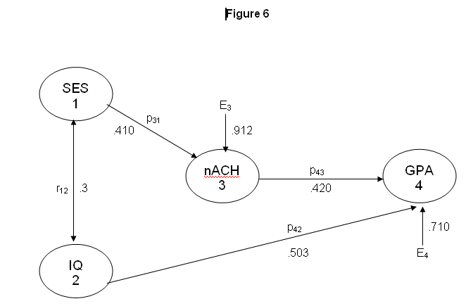

Slide 39
rr = reproduced correlation, r = original
rr₁₂ = r₁₂ = .3
rr₁₃ = p₃₁ = .41 = r₁₃
rr₁₄ = p₄₃p₃₁ + p₄₂r₁₂ = .172 + .151 = .323 r₁₄ = .330
rr₂₃ = p₃₁r₁₂ = .123 r₂₃ = .160
rr₂₄ = p₄₂ + p₄₃p₃₁r₁₂ = .503 + .052 = .555 r₂₄ = .570
rr₃₄ = p₄₃ + p₄₂r₁₂p₃₁ = .420 + .062 = .482 r₃₄ = .500

Slide 40
A More Complex Model
Path models can get a lot more complex than those we have discussed here so far.
Multiple regression software can still be used to conduct the analysis, but
Best to use software designed for structural equation modeling,
Such as Proc Calis in SAS.

Slide 41
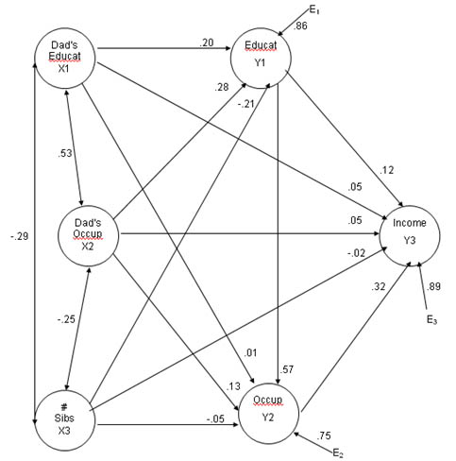

Slide 42
Trimming Models
Which paths to drop? Those not significant?
But with large N, even trivial effects will be significant.
Trim any path with |β| less than .05?
And any which have |β| less than .1 AND don’t make sense?

Slide 43
Evaluating Trimmed Models
Does the model still fit the data adequately after trimming paths?
There are a variety of goodness of fit indices that have been developed to answer this question. We shall study these later.

