Slide 1
Multiple Regression
Done with Matrix Algebra

Slide 2
Misanthropy, Idealism, and Attitudes Towards Animals
Wuensch, K. L., Jenkins, K. W., & Poteat, G. M. (2002). Misanthropy, idealism, and attitudes towards animals. Anthrozoös, 15, 139-149.
Attitude predicted from
Idealism
Relativism
Misanthropy
Gender/Sex (1 = female, 2 = male)

Slide 3
R_{iy}, the column vector of correlations between X_{i} and Y
 | ar
ideal | 0.0501
relat | 0.1581
misanth | 0.2259
gender | -0.1158

Slide 4
R_{ii}, the matrix of correlations among X’s
 | ideal | relat | misanth | gender
ideal | 1.0000 | -0.0870 | -0.1395 | -0.1011
relat | -0.0870 | 1.0000 | 0.0525 | 0.0731
misanth | -0.1395 | 0.0525 | 1.0000 | 0.1504
gender | -0.1011 | 0.0731 | 0.1504 | 1.0000

Slide 5
proc iml;
reset print;
ii ={
1.0000 -0.0870 -0.1395 -0.1011,
-0.0870 1.0000 0.0525 0.0731,
-0.1395 0.0525 1.0000 0.1504,
-0.1011 0.0731 0.1504 1.0000};
iy = {0.0501, 0.1581, 0.2259, -0.1158};
betas = inv(ii)*iy;
quit;

Slide 6
betas 4 rows 1 col 0.0836750 idealism 0.1636146 relativism 0.2526405 misanthropy
-0.1572980 male

Slide 7
0.0501(.0837) + 0.1581(.1636) + 0.2259(.2526) +
(-0.1158)(-.1573)
= .1053.

Slide 8
Test R²
s_{y} = 0.52979, n = 153, so SS_{Y} = 152(0.52979)² = 42.663.
MS_{regr} = 4.492 / 4 = 1.123 MS_{error} = 38.171 / 148 = .258
F(4, 148) 1.123/.258 = 4.353, p = .002

Slide 9
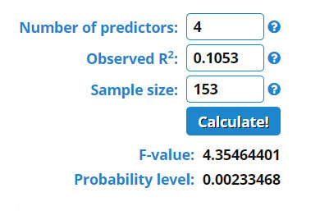
Test R² the Easy Way
https://www.danielsoper.com/statcalc/calculator.aspx?id=15

