Slide 1
Continuous Moderator Variables
in Multiple Regression Analysis

Slide 2
What is a Moderator?
A variable that alters the relationship between two or more other variables.
If the relationship between X and Y varies across levels of M, then M is a moderator.
“Moderation” is nothing more than what we called “interaction” in factorial ANOVA

Slide 3
Misanthropy, Idealism, and Attitudes About Animals
Same data I used to illustrate a Potthoff analysis.
But idealism will not be dichotomized.
The criterion variable is score on the first subscale of the Animal Attitudes scale.
The Animal Rights subscale
12 Likert-type items
Cronbach alpha = .87.

Slide 4
Download
Moderate.dat from my data files page.
Moderate.sas from my SAS programs page.
Point the program to the data file.
Run the program.

Slide 5
Center the Variables ?
Subtract mean from each score
For all predictor variables that are involved in the interaction(s)
This is commonly done and believed to prevent problems with
Multicollinearity
And other things (see Howell)
May center the outcome variable too, but that is not necessary.

Slide 6
Don’t Center the Variables
As recently demonstrated by Andrew Hayes, it is NOT necessary to center the predictors.
It may, however, be easier to interpret the results if they are centered.

Slide 7
Standardize the Variables
Unstandardized regression coefficients are rarely useful for the psychologist.
Just standardize all of the variables to z scores.
Which, of course, are centered.
proc standard mean=0 std=1 out=Zs;

Slide 8
Create the Interaction Term(s) & Run the Regression
data Interaction; set Zs;
Interact = Misanth*Ideal;
proc corr; var AR Misanth Ideal Interact;
proc reg; model AR = Misanth Ideal interact / stb tol; run;

Slide 9
Regression Output
R² = .113 , p < .001
Z_{AR} = .303∗Z_{Misanth} + .067∗Z_{Ideal} − .146∗Z_{interact} - .02
The interaction is significant, p = .049.
What does the regression look like for low (-1), medium (0), and high (+1) values of the moderator?

Slide 10
Idealism = Low (-1)
Substitute (-1) for Z_{ideal}
Remember Z_{interact} =Z_{Idealism} ∗ Z_{Misanthropy}
.303∗ Z_{M} + .067∗(-1) + (-.146)∗(-1)∗ Z_{M} - .02
Z_{AR} = .449∗ Z_{Misanth} - .069
AR increases by .449 SD for each one SD increase in Misanth
Now, watch this simple slope decrease as we increase idealism.

Slide 11
Idealism = Medium (0) or High (+1)
Medium Idealism 303∗ Z_{M} + .067∗(0) + .146∗(0)∗ Z_{M} - .02
Z_{AR} = . 303∗ Z_{Misanth} - .02
High Idealism
.303∗ Z_{M} + .067∗(1) + (-.146)∗(1)∗ Z_{M} -.02
Z_{AR} = .157∗ Z_{Misanth} + .065

Slide 12
Find 2 Points for Each Line
Low Idealism: Z_{AR} = .449∗ Z_{Misanth} - .069
Low Idealism, Low Misanthropy:
Z_{AR} = .449(-1) -.069 = -.518
Low Idealism, High Misanthropy:
Z_{AR} = .449(+1) - .069 = .380

Slide 13
Mean Idealism: Z_{AR} = . 303∗ Z_{Misanth} - .02
Mean Idealism, Low Misanthropy:
Z_{AR} = .303(-1) - .02 = -.305
Mean Idealism, High Misanthropy:
Z_{AR} = .303(+1) - .02 = .301

Slide 14
High Idealism: Z_{AR} = .157∗ Z_{Misanth} + .065
High Idealism, Low Misanthropy:
Z_{AR} = .157(-1) + .065 = -.092
High Idealism, High Misanthropy:
Z_{AR} = .157(+1) + .065 = .222

Slide 15
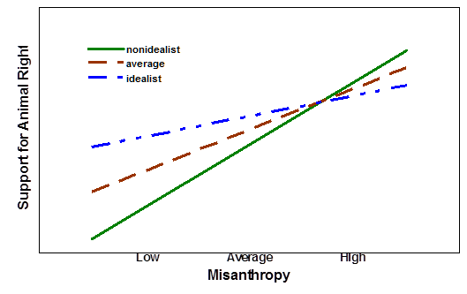
Plot the Three Lines

Slide 16
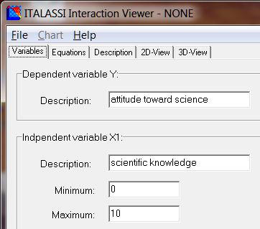
Use Italassi

Slide 17
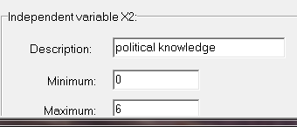
It Comes with Data

Slide 18
Click the Equations Tab
You get Y predicted from X₁
Y predicted from X₂
Y predicted from X₁ and X₂
Y predicted from X₁ and X₂ and the interaction term

Slide 19
Click on the 2-D View Tab
Select the predictor variable to display on the abscissa.
Select “Multiple with interaction.”
Move the slider to change the value of the moderator variable.

Slide 20
Click on the Variables Tab
Enter these values
Dependent = AR
Independent X1 = Misanthropy
Minimum = -1.97
Maximum = 2.5
Independent X2 = Idealism
Minimum = -2.54
Maximum = 2.54

Slide 21
Click on the Equations Tab
Enter the parameters for our Misanthropy x Idealism interaction model.

Slide 22
Click on the 2-D Tab
Model: Multiple with interaction
Misanthropy on the abscissa.
Move the slider to vary the level of idealism.

Slide 23
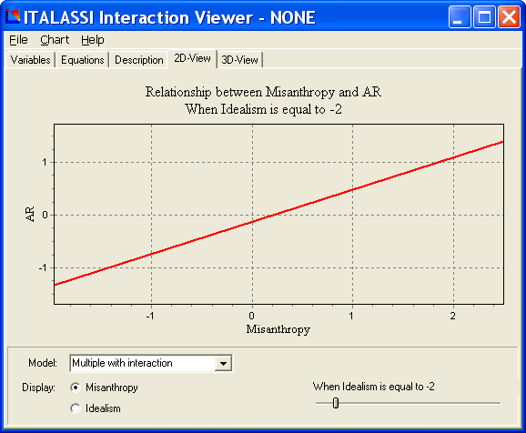

Slide 24
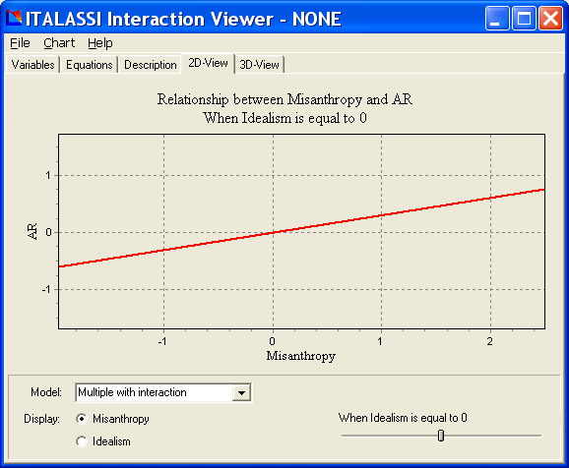

Slide 25
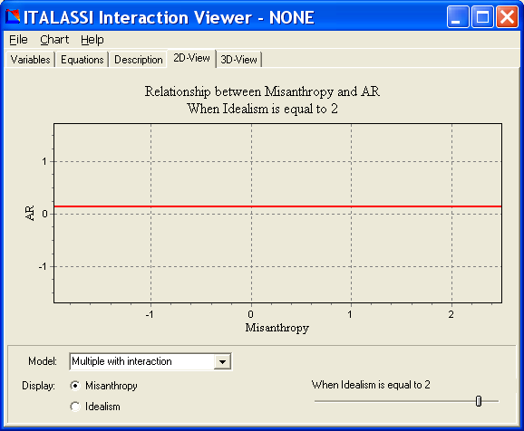

Slide 26
Main Effects vs Moderation
Imagine a study where the variables are
Level of stress (state)
Dose, in mg, of a new drug (nopressor) designed to reduce blood pressure.
SBP, patients resting systolic blood pressure minus the systolic blood pressure considered to be normal/healthy for a person of the subject’s age and sex.

Slide 27
I frequently find my students writing statements (hypotheses) like this: “Dose of nopressor will moderate the effect of stress on systolic blood pressure such that those with high stress will exhibit lower blood pressure when the dose of nopressor is high. That is, nopressor will mitigate the hypertension caused by high stress.” Then I have to explain that the presence of a mitigating effect does not establish moderation.

Slide 28
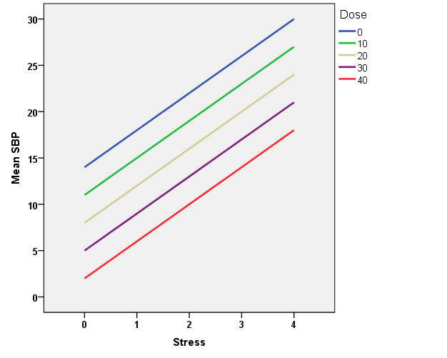
Mitigation With No Moderation

Slide 29
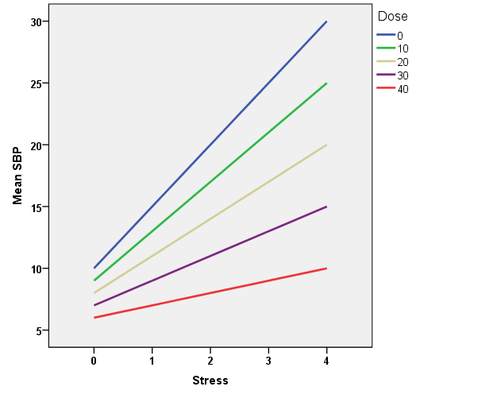
Mitigation With Moderation

