Slide 1
Skewness & Kurtosis
Karl L. Wuensch
Department of Psychology
East Carolina University

Slide 2
Karl Pearson (1895)
Population modes are not well estimated from sample modes.
Estimated difference between mean and mode = 3x the difference between mean and median.

Slide 3
Mean vs Median
These days the ‘3’ is dropped, so
Ranges from -1 to +1.
|Value| > .2 = great skewness

Slide 4
Fisher’s Skewness
The expected value of the distribution of cubed z scores
The parameter is estimated with

Slide 5
Pearson’s Kurtosis (1905)
The expected value of the distribution of z⁴
Designed to measure how flat-topped a symmetric distribution is relative to a normal distribution.
For normal distribution, β₂ = 3.

Slide 6
Fisher’s Kurtosis
AKA, “Kurtosis Excess.”
γ₂ = β₂ ‑ 3
γ₂ < 0 → platykurtic
γ₂ ~ 0 → mesokurtic (as is normal distrib.)
γ₂ > 0 → leptokurtic
Estimated with g₂

Slide 7
DeCarlo, 1967
Kurtosis is actually more influenced by scores in the tails of the distribution than scores in the center.
Platykurtic = thin in the tails.
Leptokurtic = fat tailed.
High kurtosis indicates the presence of outliers.

Slide 8
Student (1927)
“Platykurtic curves have shorter ‘tails’ than the normal curve of error and leptokurtic longer ‘tails.’
memoria technica, where the first figure represents platypus and the second kangaroos, noted for lepping.”

Slide 9
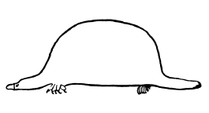
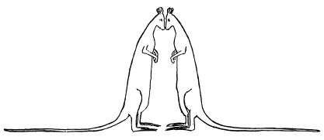
Memoria Technica

Slide 11
Moors (1986)
Kurtosis is the extent to which scores are dispersed away from the shoulders of a distribution, where the shoulders are the points where Z² = 1, that is, Z = ±1.

Slide 12
Balanda & MacGillivray (1988)
“it is best to define kurtosis vaguely as the location- and scale-free movement of probability mass from the shoulders of a distribution into its centre and tails.”

Slide 13
Confusion
When looking at frequency distributions, It is easy to confuse low kurtosis with high variance.
See the illustrations in my handout.

Slide 14
Kurtosis and Shoulders
I shall present a series of frequency distributions.
For each, the standard deviation is five,
and the mean is 10.
So the shoulders are at 5 and 15.
As we move from one distribution to the next, scores are moved further and further from the shoulders.

Slide 15
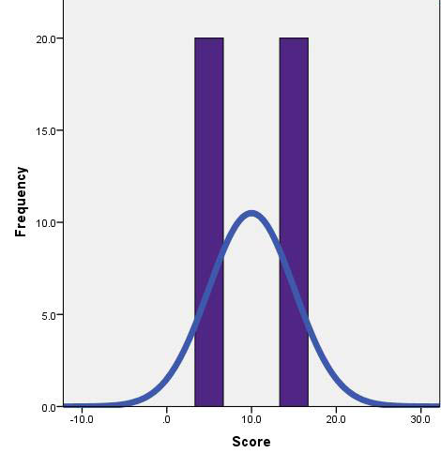
Kurtosis = -2.0
All of the scores are at the shoulders, none in the middle or the tails. This is a two-point binomial distribution, p = .5. I have superimposed a normal distribution so you can see where the shoulders are on a normal distribution.

Slide 16
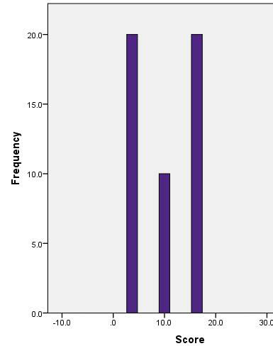
Kurtosis = -1.75
Some scores have been moved from the shoulders towards the tails, others from the shoulders to the middle. The distribution now has a V shape.

Slide 17
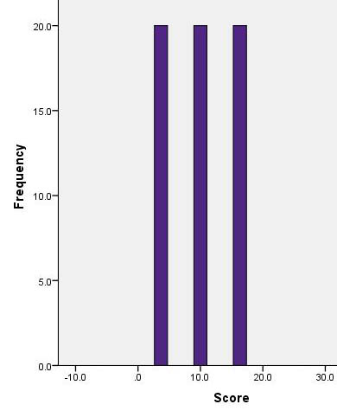
Kurtosis = -1.5
The minimum and maximum scores have been moved further into the tails or moved into the center.

Slide 18
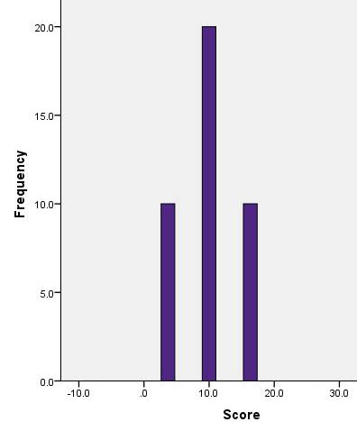
Kurtosis = -1.0
The minimum and maximum scores have been moved even further into the tails or moved into the center.

Slide 19
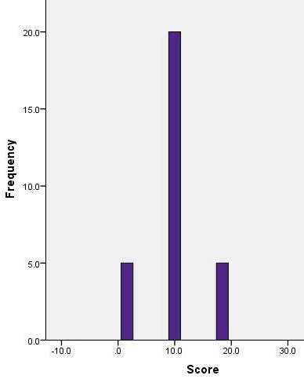
Kurtosis = 0
This distribution has the same kurtosis as a normal distribution.

Slide 20
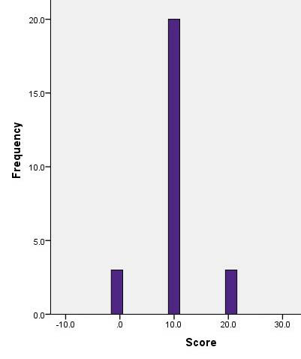
Kurtosis = 1.33
This distribution has a greater kurtosis than the normal distribution – fewer scores in its shoulders than a normal distribution has.

Slide 21
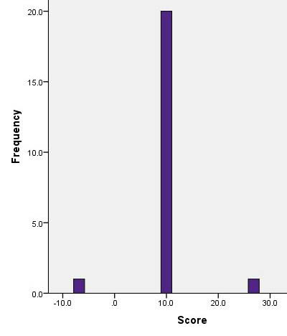
Kurtosis = 8.0
The scores in this distribution are even further away from its shoulders. One could call this a “fat-tailed” distribution – it has an unusually large proportion of its scores way out in the tails.

Slide 22
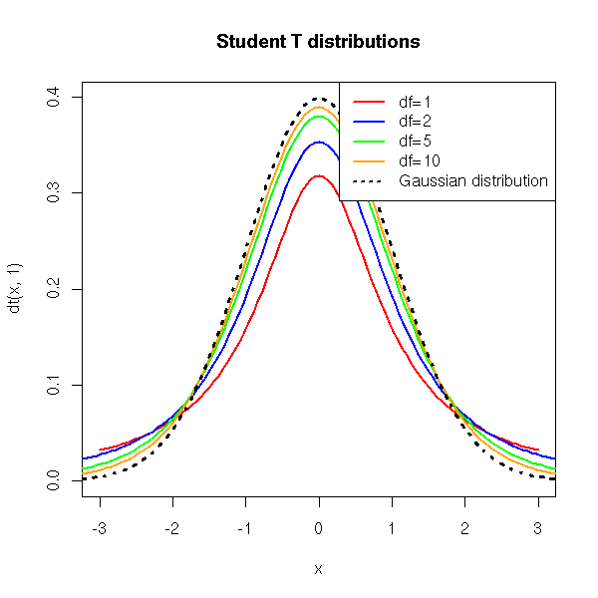
You will be working with Student’s t distribution. It has kurtosis greater than that of a normal distribution, especially when its df are low. In the plot to the left, the dotted line is for the normal distribution. Notice that the t distributions have fat tails. Remember this when we start talking about the critical values for the t distribution.

Slide 23
Platykurtic Distributions
These are distributions with kurtosis distinctly less than zero.
They have short or absent tails.
Student, pseudonym for William Gosset, drew this platypus to help remember that platykurtic distributions have short tails.

Slide 24
Leptokurtic Distributions
These have high kurtosis, and thus long tails. Gosset drew these lepping (leaping) kangaroos to help him remember that leptokurtic distributions have long tails.

Slide 25
Testing the Normality Assumption
Don’t do it.
With large sample sizes the normality assuming test is more robust to the assumption but the test of normality is so powerful that it will detect as significant deviations from normality that are too small to be troublesome’

Slide 26
With small sample sizes the normality assuming test will be less robust but the test of normality may have so little power that it fails to detect even serious deviations from normal.

Slide 27
What to do Instead
Compute within group measures of skewness and kurtosis.
If absolute values are less than 1, not to worry.
If skewness is a problem, try a skewness-reducing transformation.
Use graphs

Slide 28
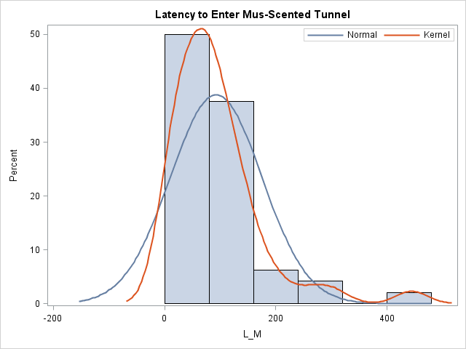
Kernel Plots

Slide 29
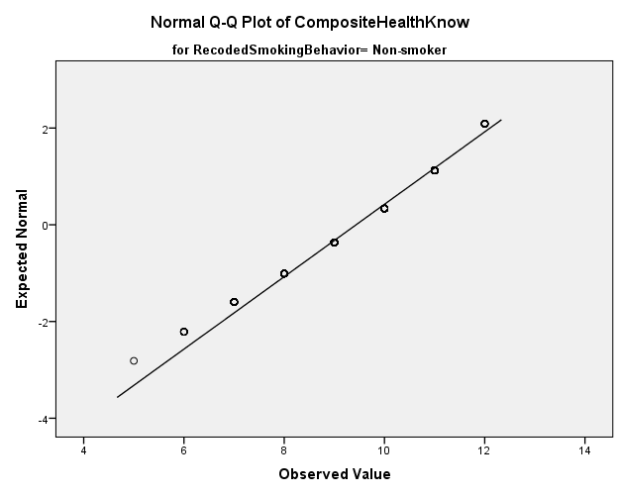
Normal Plots

Slide 30
Additional Reading
http://core.ecu.edu/psyc/wuenschk/docs30/Skew-Kurt.docx

