Slide 1
Two-Way χ²
Karl L. Wuensch
Department of Psychology
East Carolina University

Slide 2
Shoes at a Commune
There are 100 shoes.
We classify each shoe as having been chewed (by the dog) or not.
And as being a man’s shoe or a woman’s shoe.
Is sex of shoe owner related to whether or not the dog chewed it?

Slide 3
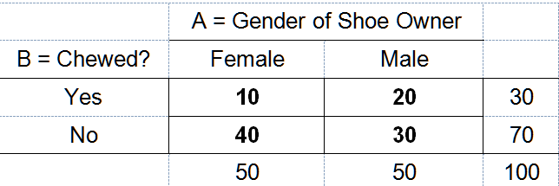
Pearson Chi-Square Test for Contingency Tables
H₀: A and B are independent (ϕ = 0)
H₁: A and B are correlated (ϕ ≠ 0)

Slide 4
The marginal probabilities of being chewed are .3 chewed, .7 not.
The marginal probabilities for gender of the owner are .5, .5.

Slide 5
For each cell, the (expected probability) is (A = a) ∗ (B = b) under the null
Remember the multiplication rule under the assumption of independence?

Slide 6
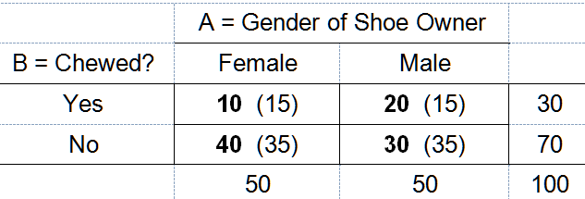
For each cell, the (expected frequency) is the expected probability times N.
Shortcut: E = row count (column count) / total N.

Slide 7
df = (# rows - 1)(# cols - 1) = (1)(1) = 1
p = .029

Slide 8
Odds Ratios
The odds that a randomly selected man’s shoe would be chewed are 20 to 30.
The odds that a randomly select woman’s shoe would be chewed are 10 to 40.
The odds ratio = (20/30) ÷ (10/40) = 2.67.
Men’s shoes are 2.67 times more likely to be chewed than are women’s shoes.

Slide 9
Shoes owned by male members of the commune were significantly more likely to be chewed by the dog (40%) than were shoes owned by female members of the commune (20%), χ²(1, N = 100) = 4.762, p = .029, odds ratio = 2.67, 95% CI [1.09, 6.02].

Slide 10
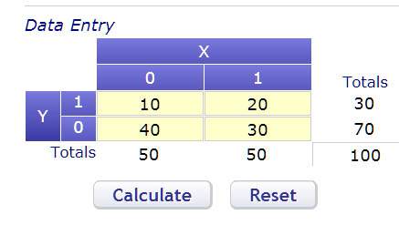
Vassar Stats

Slide 11
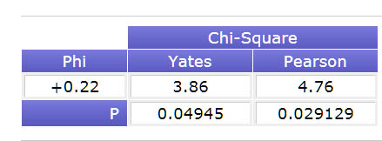
The Yates correction should almost never be used in a contingency table analysis
Few researchers understand this.

Slide 12
More Complex Contingency Tables
Could have more than two categories for rows and or columns.
Could have more than two categorical variables.
See Two-Dimensional Contingency Table Analysis with SPSS

