Slide 1
The Oneway Chi-Square Test
Karl L. Wuensch
Department of Psychology
East Carolina University

Slide 2
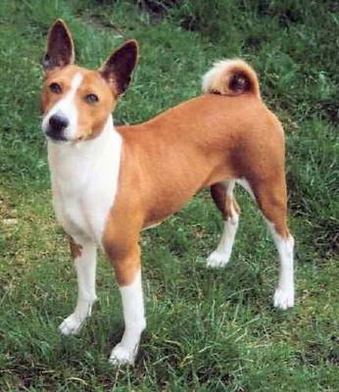
The Basenji is fearful of strangers.

Slide 3
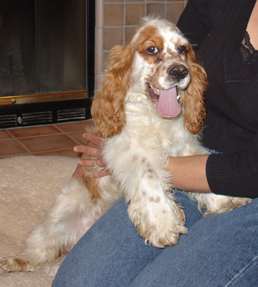
The cocker spaniel is not.

Slide 4
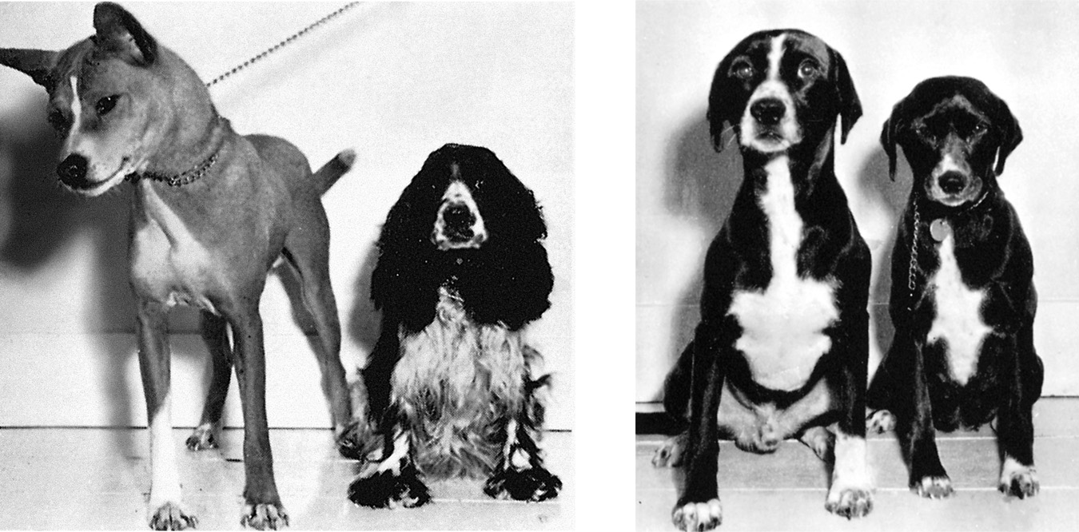
What About A Cockenji?

Slide 5
Inheritance of Fearfulness
John Paul Scott and John Fuller
Basenji x Basenji → fearful pups
Cocker x Cocker → fearless pups
Basenji x Cocker → fearful pups
Dominant F gene codes for Fearfulness
Recessive f gene codes for fearlessness
F₁ dogs are heterozygous, Ff

Slide 6
Breed F₁ Dogs With Each Other
 | Mother
Father | F | f
F | FF | Ff
f | fF | ff

Slide 7
Model Prediction
H₀: 75% of the babies will fear strangers, those with FF, Ff, or fF genotypes.
H₁: the percentage is not 75%
The data: 18 of 25 puppies (72%) were fearful of strangers.
The analysis: a one-way goodness of fit test.

Slide 8
Eighty Puppies
55 are fearful (69%), 25 not (31%)
We expected 75% to be fearful = 60 pups
And 25% not fearful, = 20 pups.
Do the observed counts differ enough from those expected to cast doubt on the model?
Puppy is | Observed | Expected
Fearful | 55 | 60
Fearless | 25 | 20

Slide 9
Chi-Square
df = k-1 = 2-1 = 1
χ²(1, N = 80) = 1.35, p = .25

Slide 10
Dominance Model Survives
The model was that the dominant gene, F, results in fearfulness and the recessive gene in fearlessness.
This model predicted that 75% of the pups would be fearful.
The p value was not small enough to reject this model.

Slide 11
Correction for Continuity
The “-.5” in the calculation is applied only when df = 1.
AKA the Yates correction.
SPSS does not apply this correction, but should.
Use the Vassar Calculator instead

Slide 12
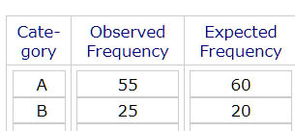
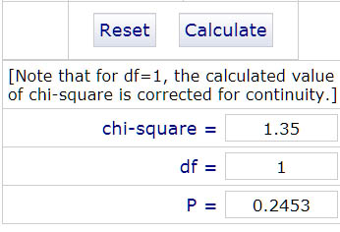

Slide 13
Codominance Model
FF pups (25%) will be high in fear
Ff pups (50%) will be moderate in fear
Ff pups(25%) will have no fear
We classify each pup as high (45), moderate (20), or low (15) in fear.
We shall not make the correction for continuity when calculating χ²

Slide 14
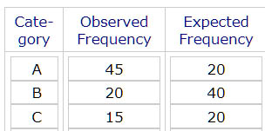
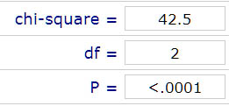
The Codominance Model is Rejected

