Slide 1
Level of English, Attention Deficit Disorder, IQ, and GPA
Example One-Way ANOVA

Slide 2
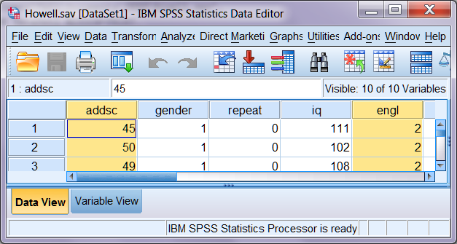
Bring the Data into SPSS
HOWELL
Data set from appendix in our textbook - see Howell Variables

Slide 3
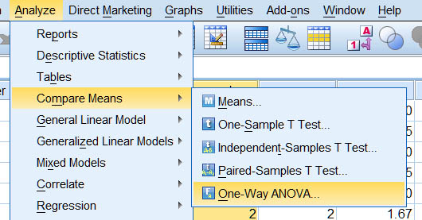
Analyze, Compare Means, ..

Slide 4
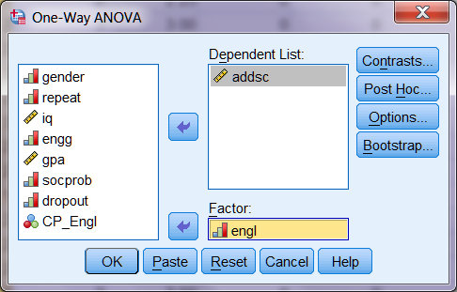
Identify X and Y
Factor is the grouping variable, Dependent is the comparison variable.

Slide 5
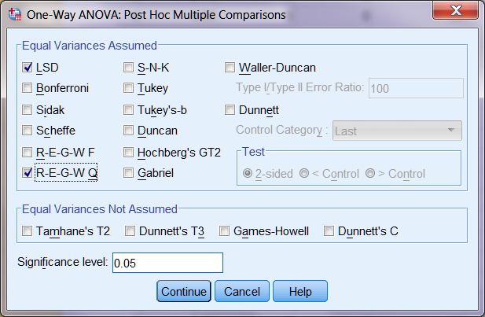
Post Hoc Tests

Slide 6
LSD or REGWQ?
With only three groups, LSD is the best choice.
With four or more groups, REGWQ is a better choice.
I have done both for pedagogical purposes.

Slide 7
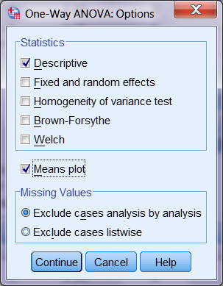
Descriptives & a Plot

Slide 8
Descriptive Statistics
Group | N | Mean | SD
Coll_Prep | 14 | 43.50 | 10.639
General | 64 | 53.41 | 11.752
Remedial | 10 | 60.20 | 12.796
Total | 88 | 52.60 | 12.422

Slide 9
ANOVA Source Table
ANOVA
addsc
 | Sum of Squares | df | Mean Square | F | Sig.
Between Groups | 1778.542 | 2 | 889.271 | 6.490 | .002
Within Groups | 11646.538 | 85 | 137.018
Total | 13425.080 | 87

Slide 10
LSD (Fisher’s Procedure)
 | (I) engl | (J) engl | Mean Difference (I-J) | Sig.
LSD | Coll_Prep | General | -9.906* | .005
 |  | Remedial | -16.700* | .001
 | General | Coll_Prep | 9.906* | .005
 |  | Remedial | -6.794 | .092
 | Remedial | Coll_Prep | 16.700* | .001
 |  | General | 6.794 | .092
The difference between Remedial and General falls short of significance.

Slide 11
REGWQ
addsc
 | engl | N | Subset for alpha = 0.05
 |  |  | 1 | 2
REGWQ | Coll_Prep | 14 | 43.50
 | General | 64 |  | 53.41
 | Remedial | 10 |  | 60.20
 | Sig. |  | 1.000 | .198
Scores significantly lower in the College Prep group than in the other two groups.

Slide 12
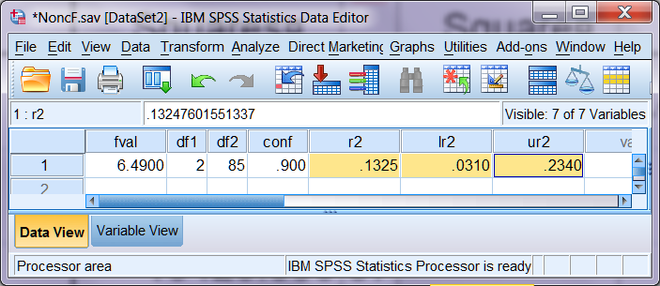
η² With 90% CI
Enter F and df into NoncF.sav and then run the associated syntax file.

Slide 13
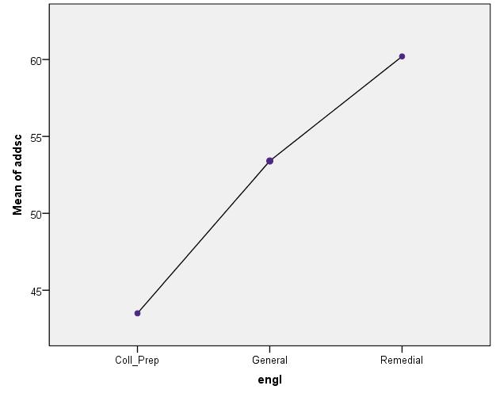
Plot of Means

Slide 14
Ninth grade students’ attention deficit disorder scores were significantly related to the level of English in which they were enrolled, F(2, 85) = 6.49, MSE = 137.02, p = .002, η² = .132, 90% CI [.031, .234]. As shown in Table 1, mean score on the attention deficit disorder scale was significantly less for students enrolled in college prep English than for students in general or remedial English.

Slide 15
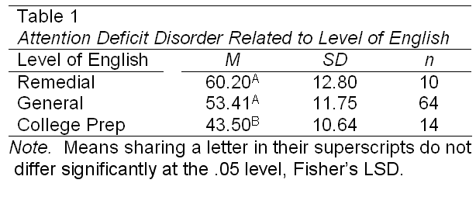

Slide 16
Another Example
I also compared the groups on IQ. For practice, you do so too and see if you get the results summarized on the following slides.

Slide 17
Ninth grade students’ IQ was significantly related to the level of English in which they were enrolled, F(2, 85) = 3.12, MSE = 160.78, p = .049, η² = .068, 90% CI [.0001, .154]. As shown in Table 2, mean IQ was significantly lower for students enrolled in remedial English than for students in general or college prep English.

Slide 18
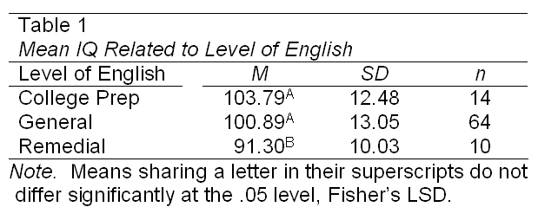

Slide 19
Yet Another Example
Comparing the groups on GPA.

Slide 20
Ninth grade students’ GPA was significantly related to the level of English in which they were enrolled, F(2, 85) = 3.93, MSE = 0.838, p = .023, η² = .084, 90% CI [.006, .176]. As shown in Table 2, mean IQ was significantly less for students enrolled in remedial English than for students in standard or college prep English. As shown in Table 3, students enrolled in college prep English had significantly higher GPA than did those enrolled in remedial English. Those in general English did not differ significantly from the other two groups.

Slide 21
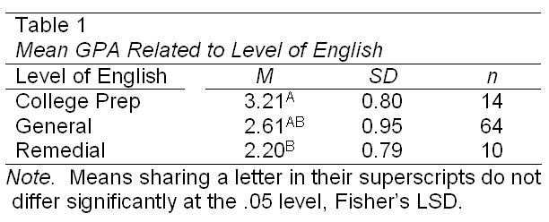

Slide 22
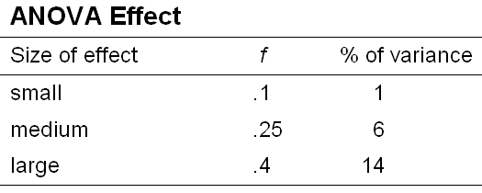
How Large are Our Values of η²?
Our values were .13, .07, & .08.
Here are Cohen’s conventions:

