Slide 1
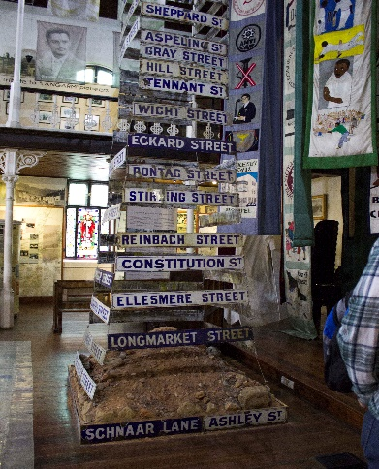
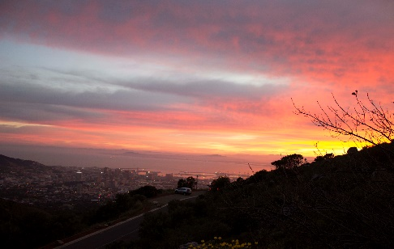
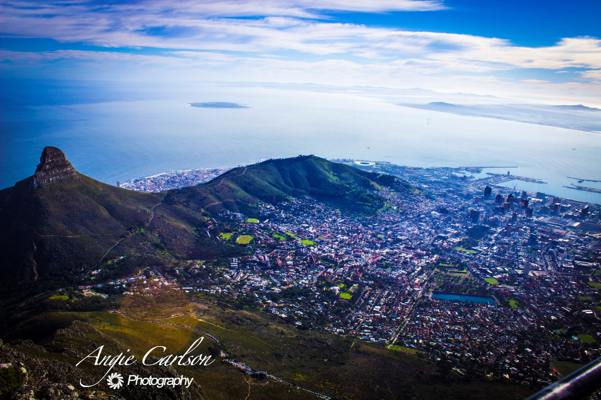
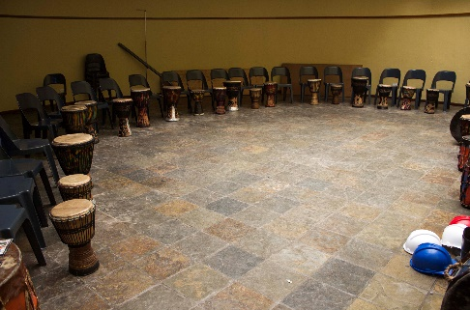
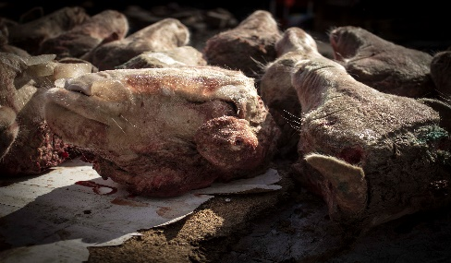
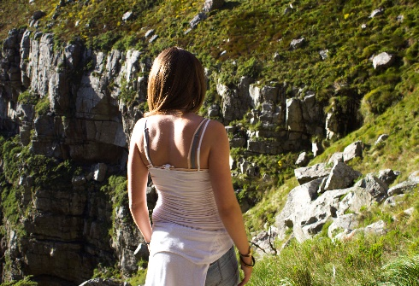
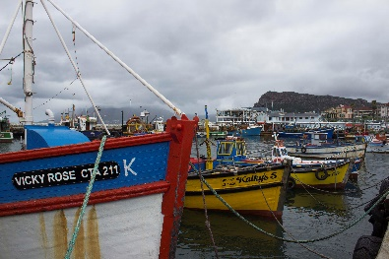
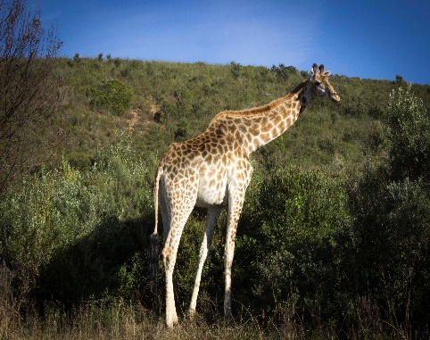
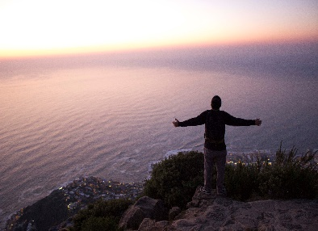
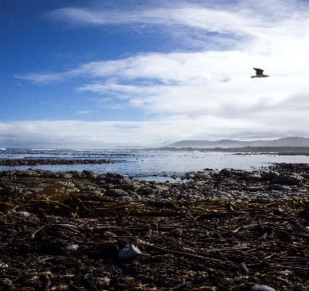
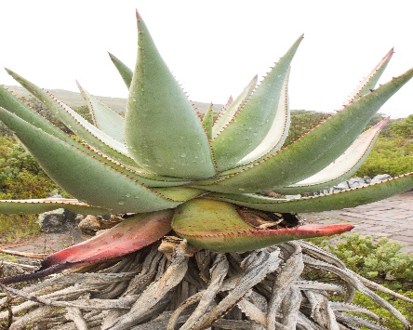
FIND YOUR ADVENTURE
Cape Town, South Africa

Slide 2
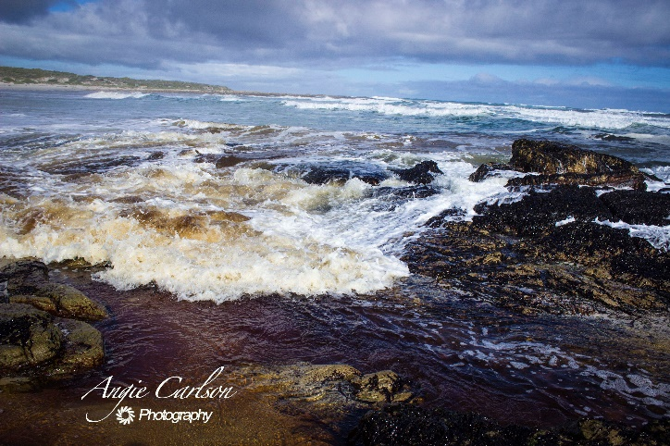
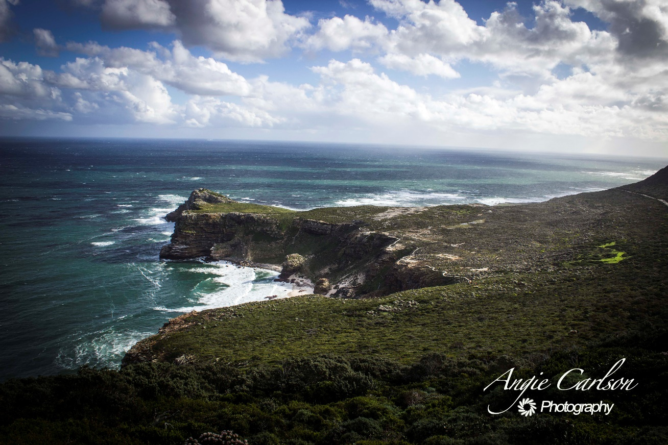
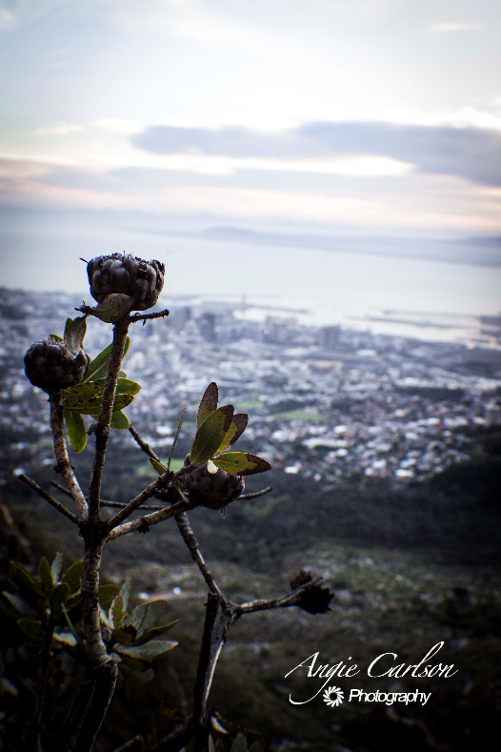
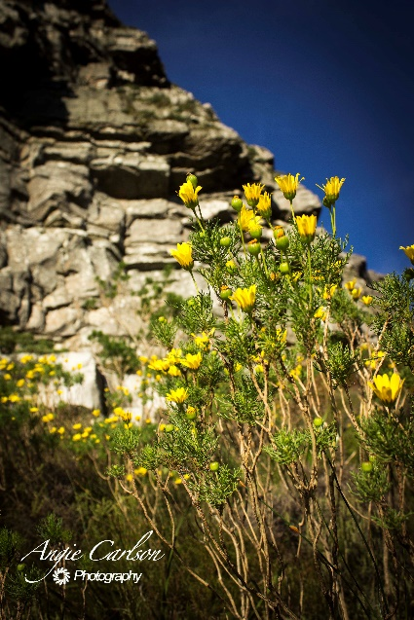
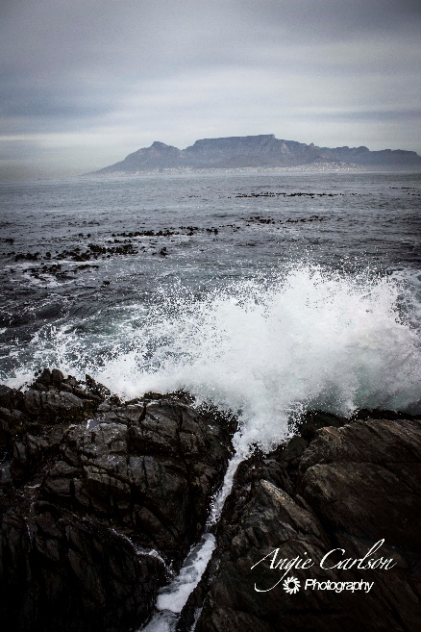
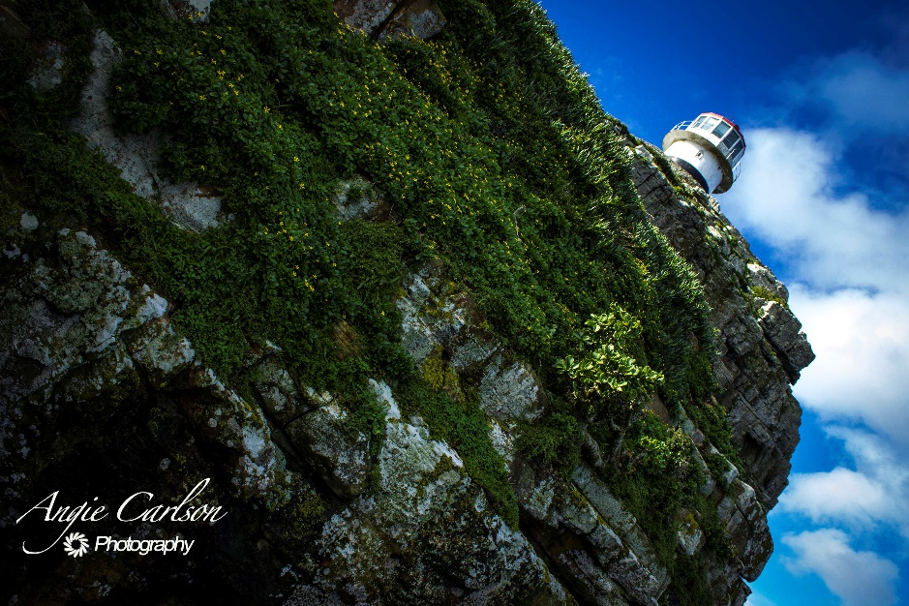
FIND
NATURE
excite your senses as you climb the beautiful Table Mountain, see the majesty of Cape Point, and enjoy all the natural beauty Cape Town has to offer
“The country itself boasts mountains, savannah, rain forests, and any other terrain you can think of. Walking around Cape Town, that is what strikes me most.” Ivor Mollema, Graduate Student, Interview

Slide 3
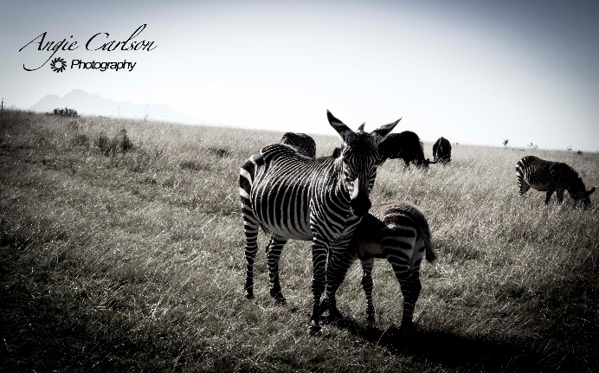
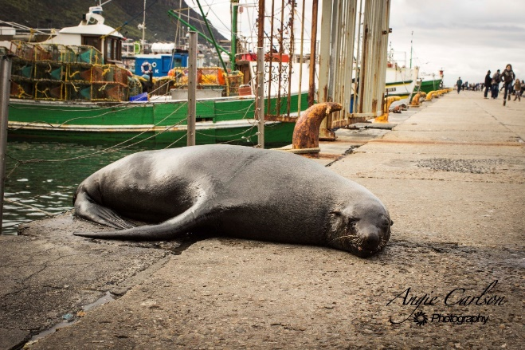
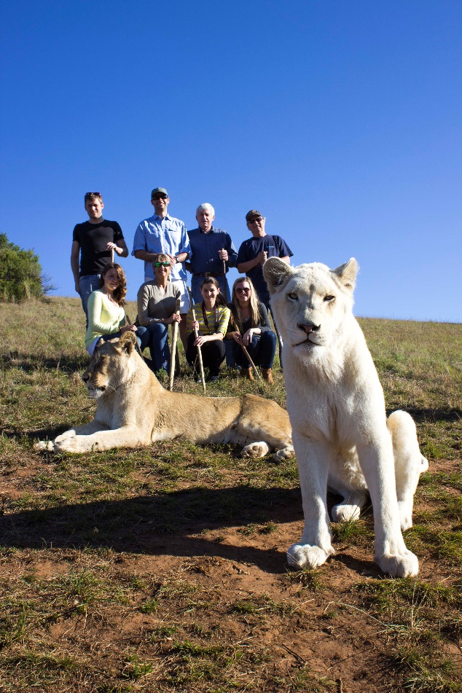
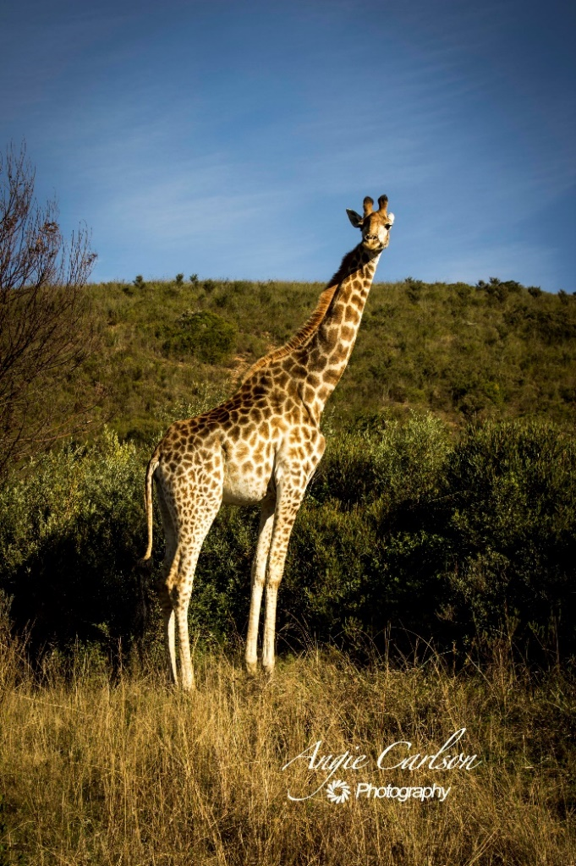
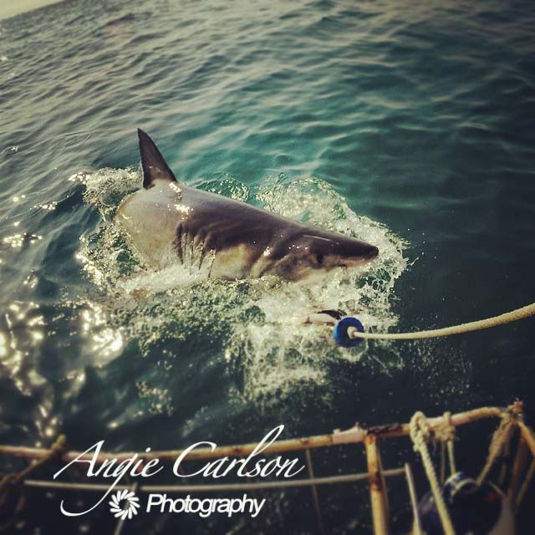
“My favorite part was the sharks. Getting so close to animals that are so majestic was awesome.” Chris Deyncourt, Undergraduate, interview
see the wildlife of South Africa up close and personal with optional activities such as shark diving, walking with lions, and a game drive through a wildlife reserve
FIND
WILDLIFE

Slide 4
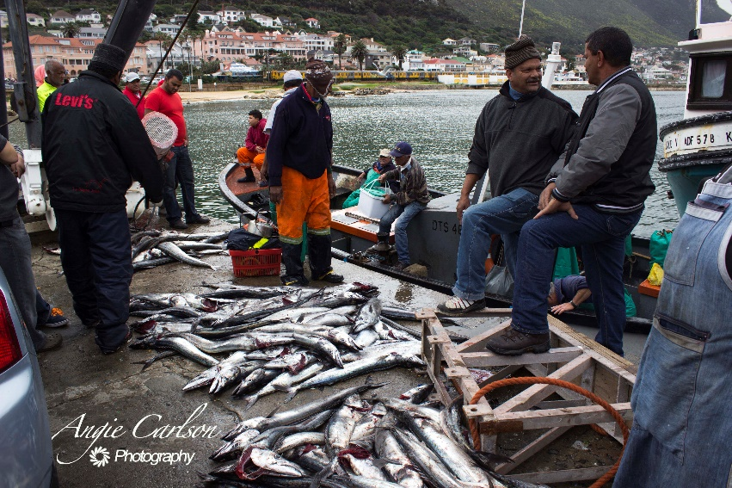
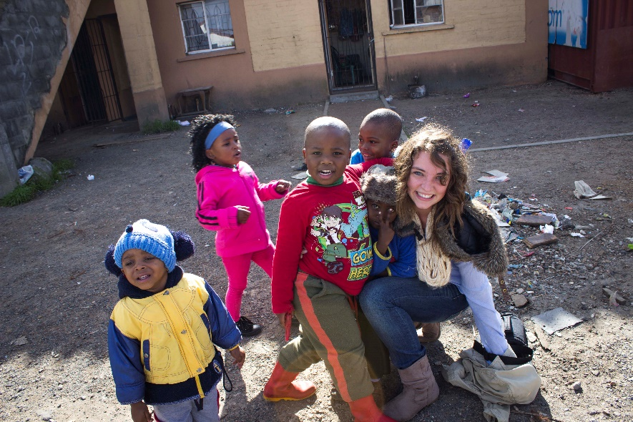
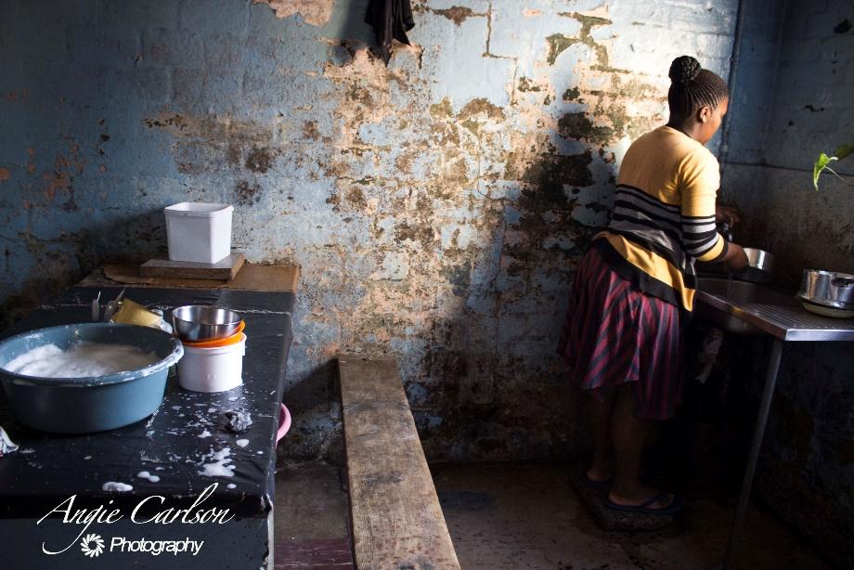
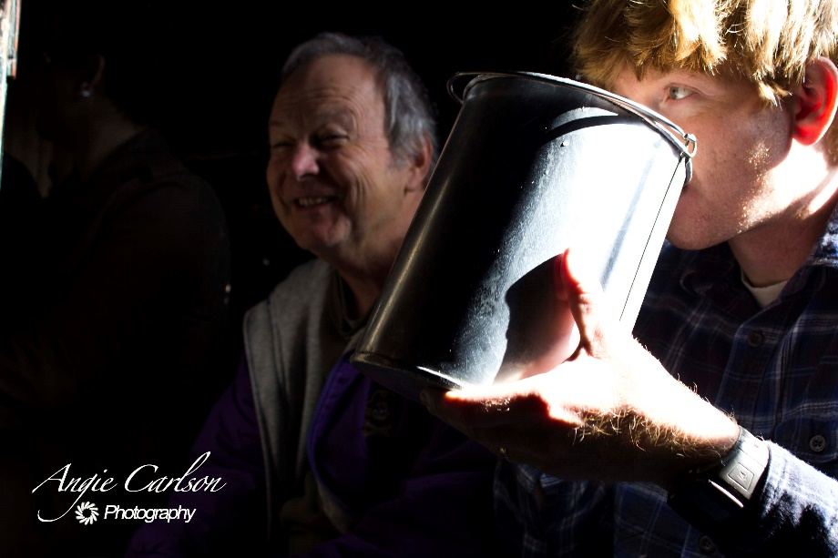
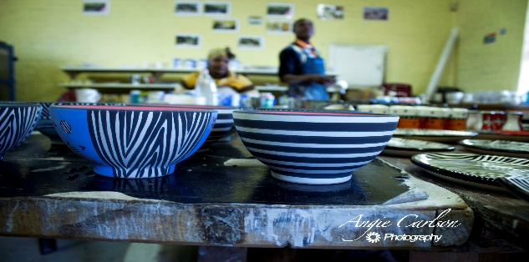
FIND
CULTURE
experience life in a new way as you visit the local townships, meet the fishermen of Kalk Bay, and discover people from all walks of life in the city that’s a true cultural melting pot
“Traveling to South Africa allows you to fully experience a culture like no other. By participating in a study abroad, you can do more than explore their culture in museums. You will be able to see the influence of past colonial powers in architecture, taste their culture in the food, and experience South Africa in a million more ways than could be possible through a book.”
Nathan King, Graduate Student, Interview

Slide 5
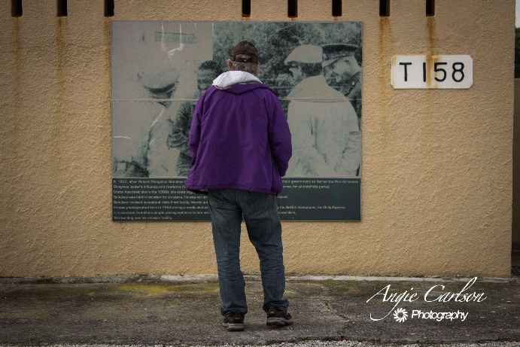
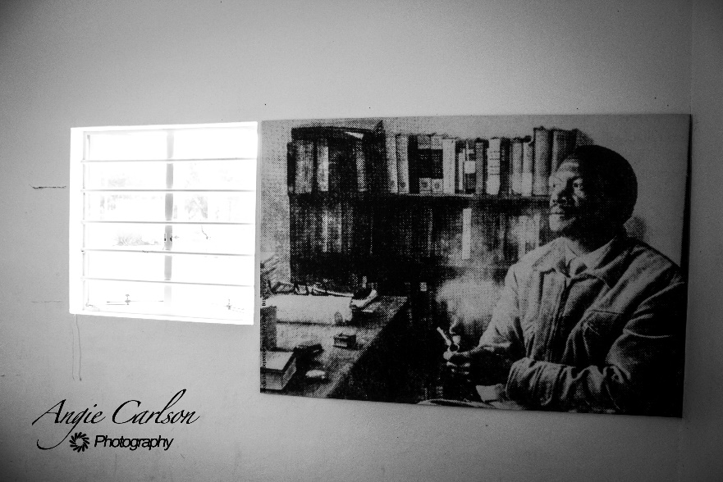
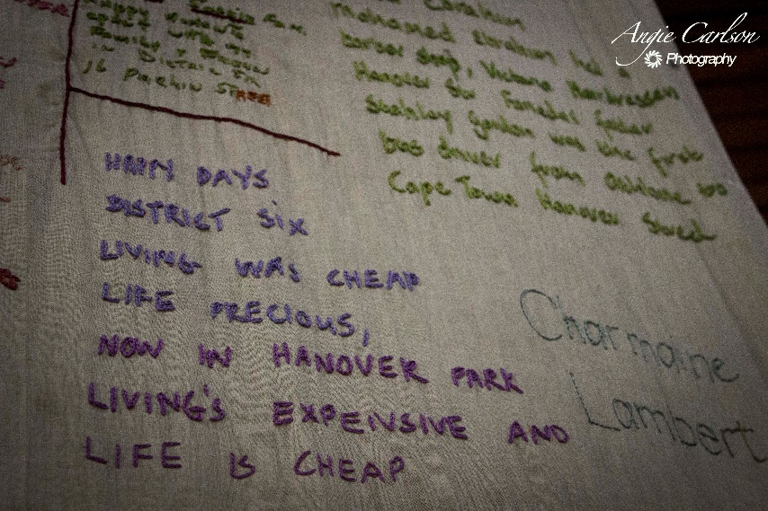
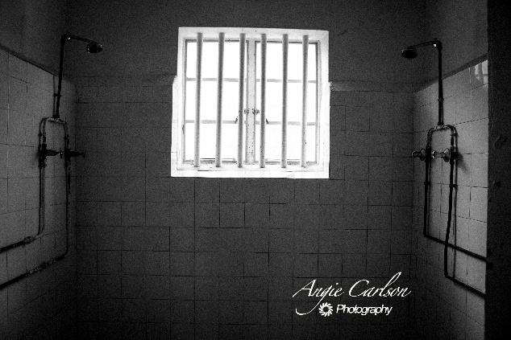
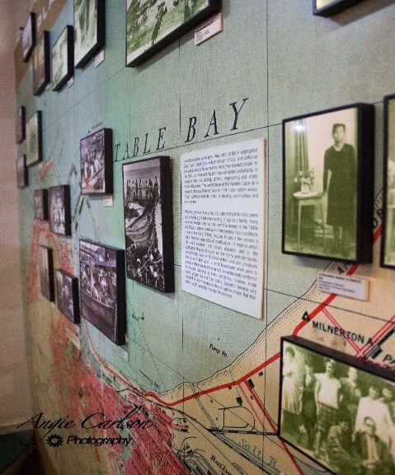
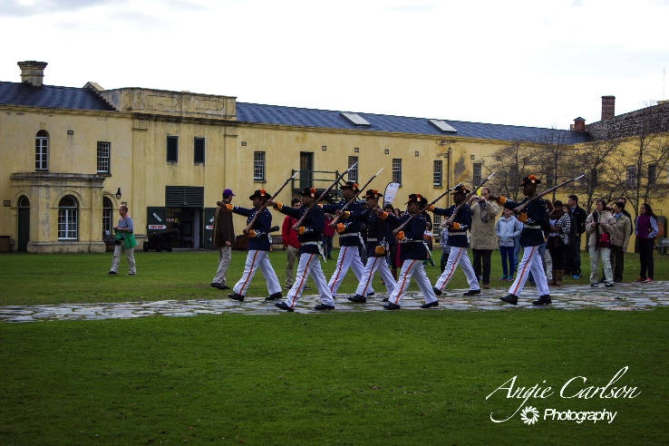

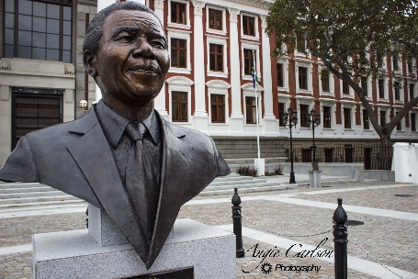
FIND HISTORY
discover the fascinating history of South Africa by visiting the UN World Heritage sight of Robben Island & eye-opening museums such as District 6 and the Castle of Good Hope, just to name a few
“It is said that no one truly knows a nation until one has been inside its jails.” (Mandela 1995)

Slide 6
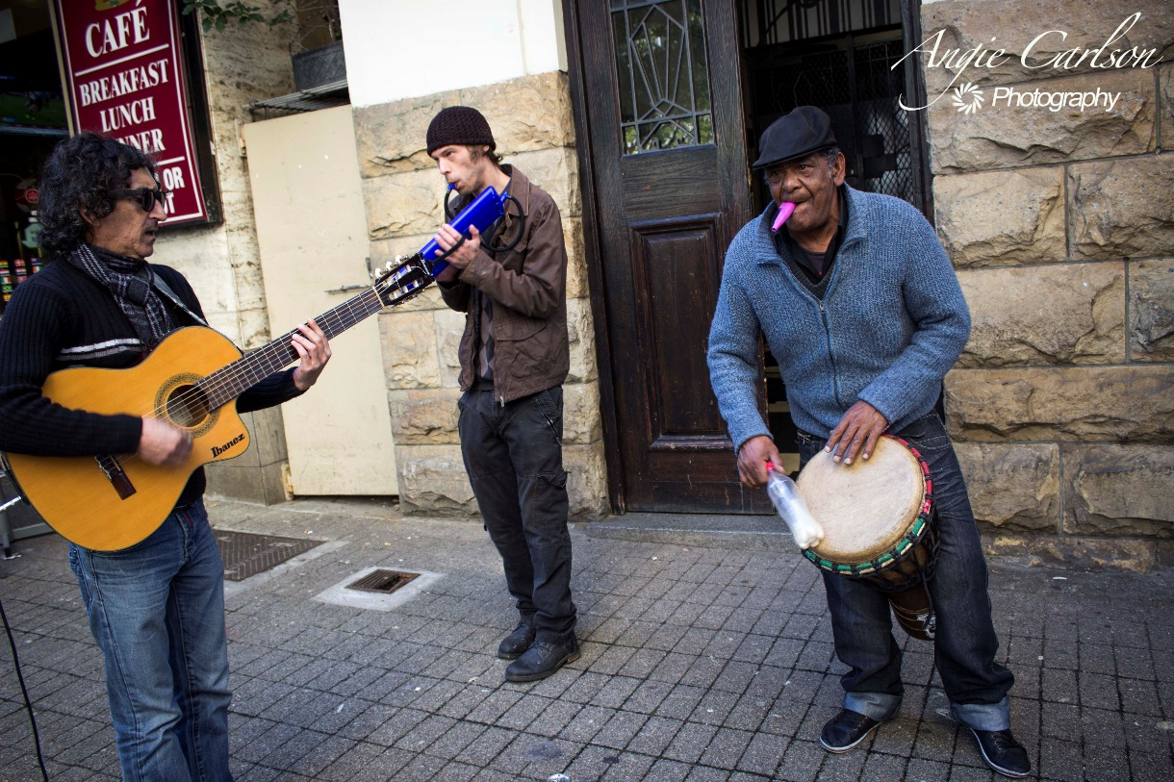
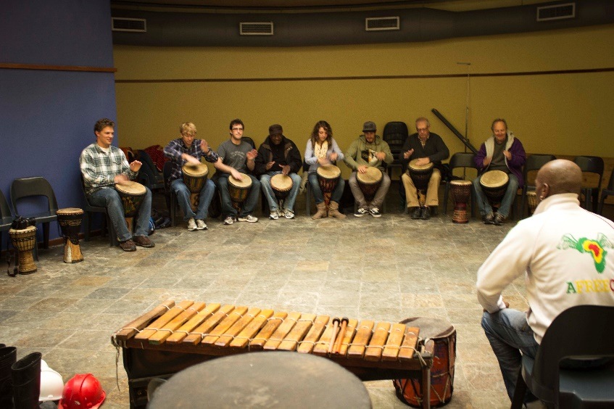
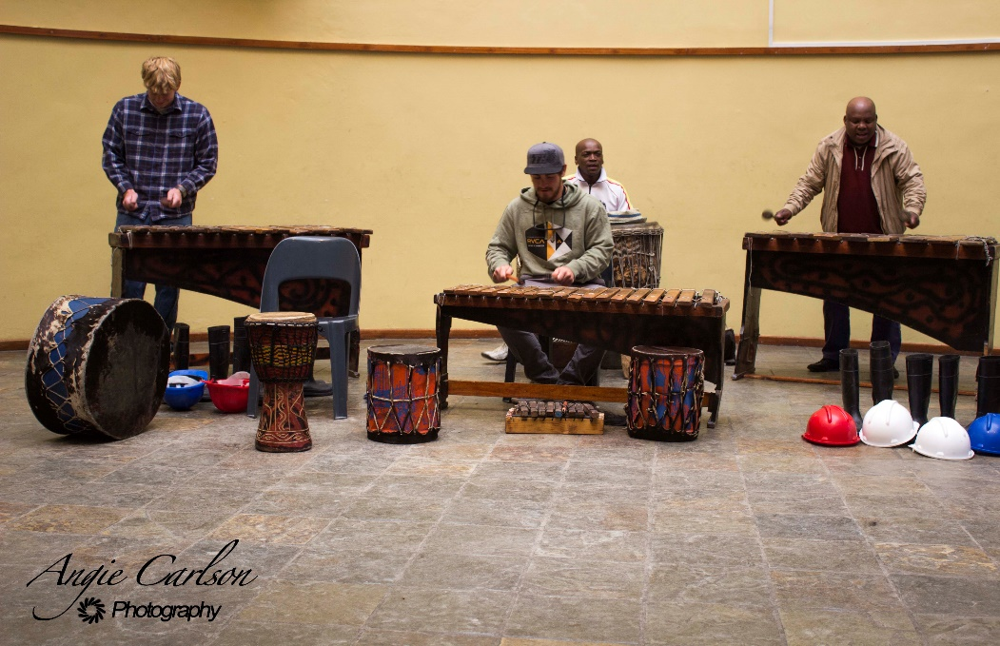
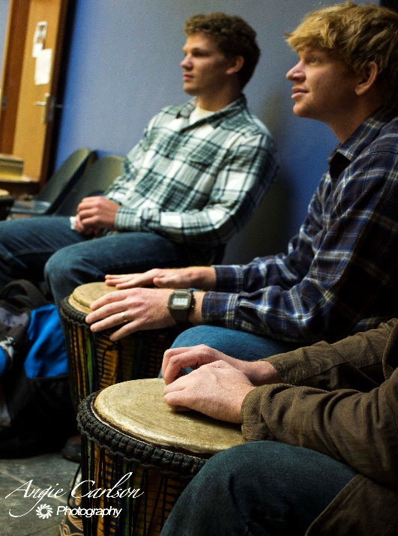
South Africa has a vibrant music scene, from street musicians to drum & bass, you’re sure to find a sound that will inspire you
“My favorite part of the trip was the exposure to South African music. We were able to play marimbas and drums. I even bought a hand carved drum there.”
Justin Edwards, Graduate Student, Interview
FIND
MUSIC

Slide 7
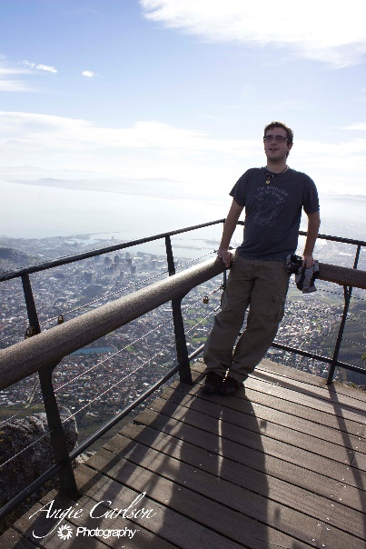
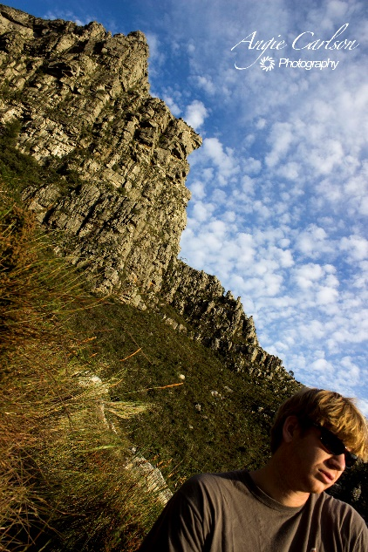
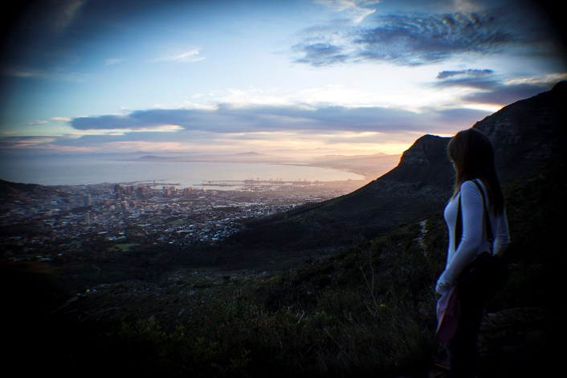
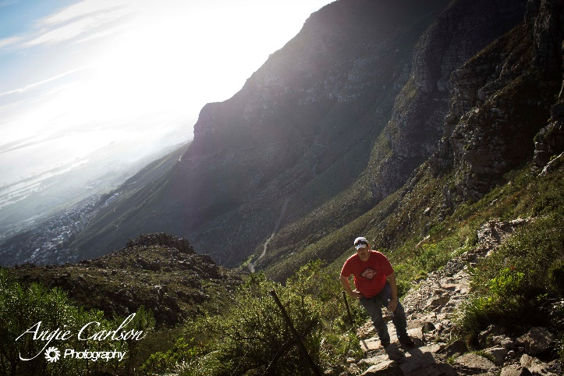
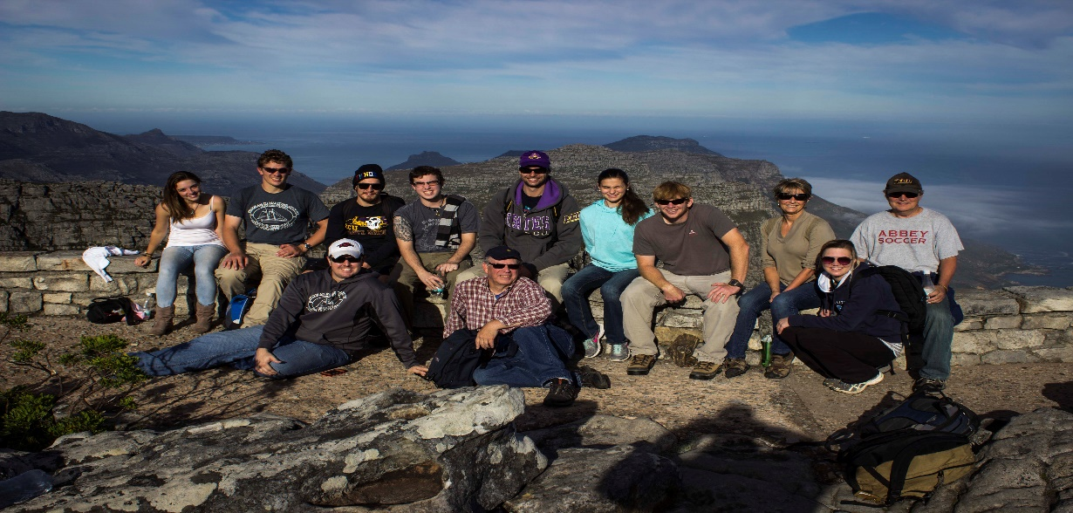
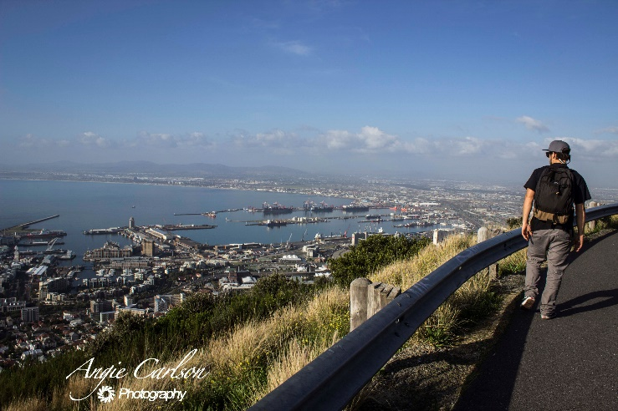
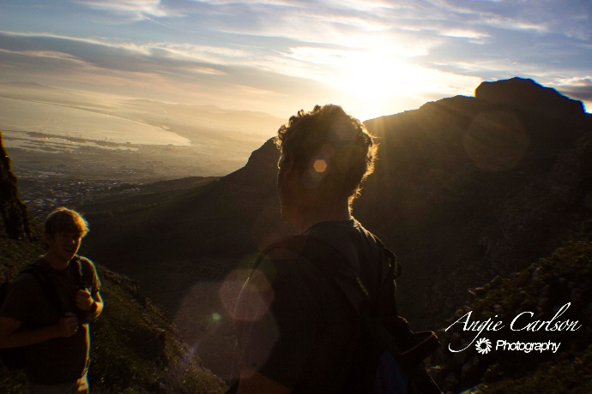
FIND
YOURSELF
“Students open their minds to greater possibilities and learn about different cultures. Learning about different cultures can instill a better understanding and tolerance for difference and diversity. I also think that it enables students to remove themselves from their comfort zones and this enables them to learn about themselves in a mature and positive way.”
Clive DeBruyne, Tour Guide, Interview

Slide 8
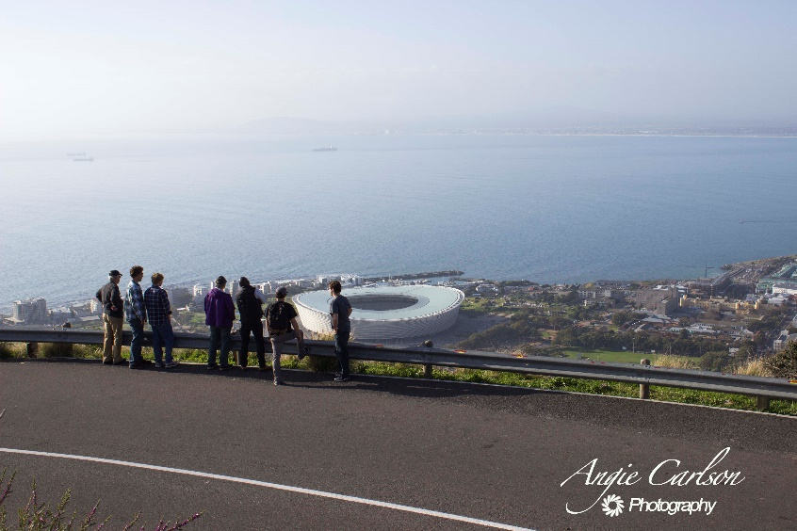
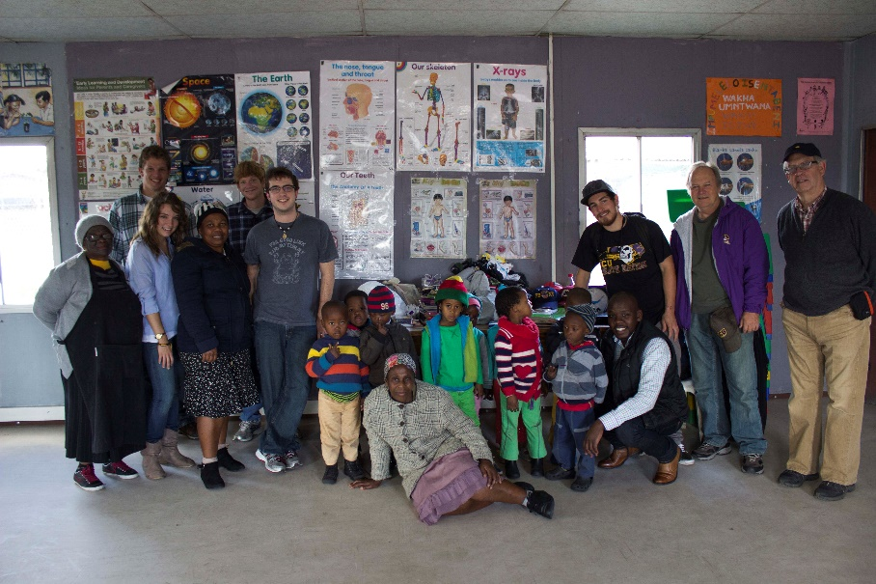
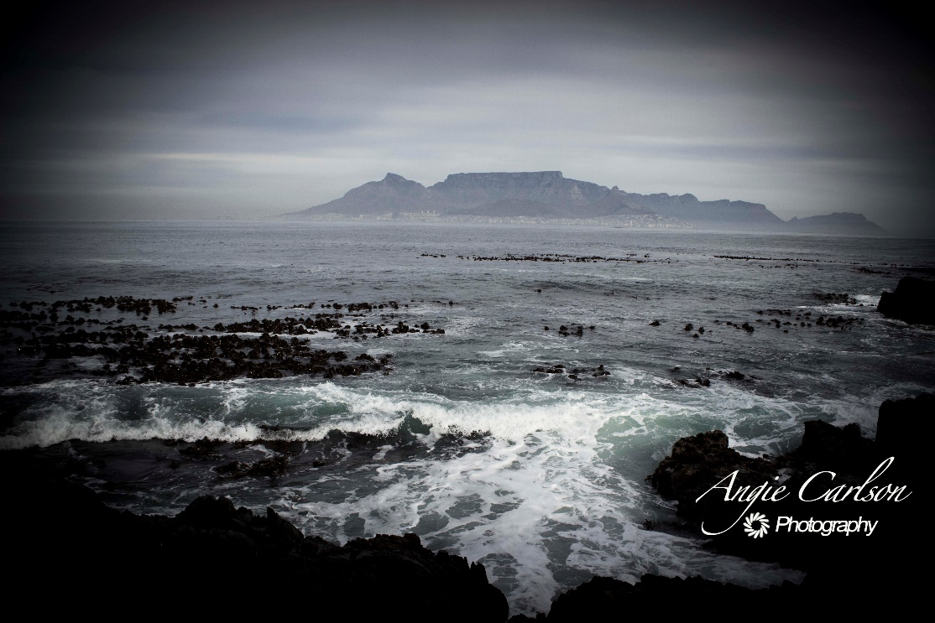
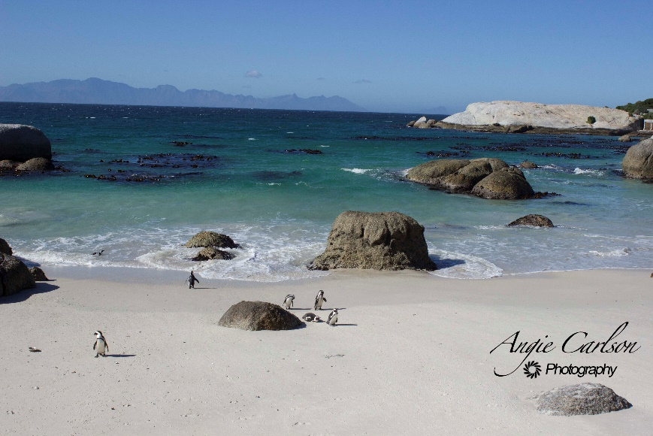
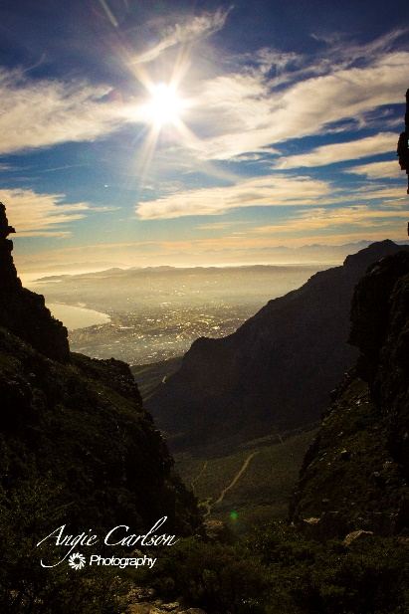





FIND
out more
For more information on the study abroad trip to South Africa contact Dr. Wilburn at wilburnk@ecu.edu,
Dr. Harris at harrisly@ecu.ecu, or the ECU Study Abroad office at 252-328-9219

Slide 9
Works Cited
Carlson, Angie. 2014. Angie Carlson Photography, Cape Town.
DeBruyne, Clive, interview by Angela Carlson. 2014. (August 12).
Edwards, Justin, interview by Angela Carlson. 2014. (August 12).
King, Nathan, interview by Angela Carlson. 2014. (August 15).
Mandela, Nelson. 1995. Long Walk To Freedom. Little Brown & Co.
Mollema, Ivor, interview by Angela Carlson. 2014. (August 13).
Deyncourt, Chris, interview by Angela Carlson. 2014. (August 12)
*If you are interested in the purchase of any photos shown or a photo session, please contact Angie Carlson at angiecarlsonphotography@gmail.com or 252-558-3309

