Slide 1
Inventory
Stock of items held to meet future demand
  Tangible goods
  Intangible goods
Inventory management answers two questions
  How much to order?
  When to order?

Slide 2
Types of Inventory
Raw materials
Purchased parts and supplies
Labor
In-process (partially completed) products
Component parts
Working capital
Tools, machinery, and equipment
Finished goods

Slide 3
Reasons To Hold Inventory
Meet unexpected demand
Smooth seasonal or cyclical demand
Meet variations in customer demand
Take advantage of price discounts
Hedge against price increases
Quantity discounts

Slide 4
Two Forms Of Demand
Dependent
  items used to produce final products
Independent
  items demanded by external customers

Slide 5
Inventory Costs
Carrying Cost
  cost of holding an item in inventory
Ordering Cost
  cost of replenishing inventory
Shortage Cost
  temporary or permanent loss of sales when demand cannot be met

Slide 6
Inventory Control Systems
Fixed-order-quantity system (Continuous)
  constant amount ordered when inventory declines to predetermined level
Fixed-time-period system (Periodic)
  order placed for variable amount after fixed passage of time

Slide 7
ABC Classification System
Demand volume & value of items vary
Classify inventory into 3 categories
Class % of Units % of Dollars
A 5 - 15 70 - 80
B 30 1515
C 50 - 60 5 - 10

Slide 8
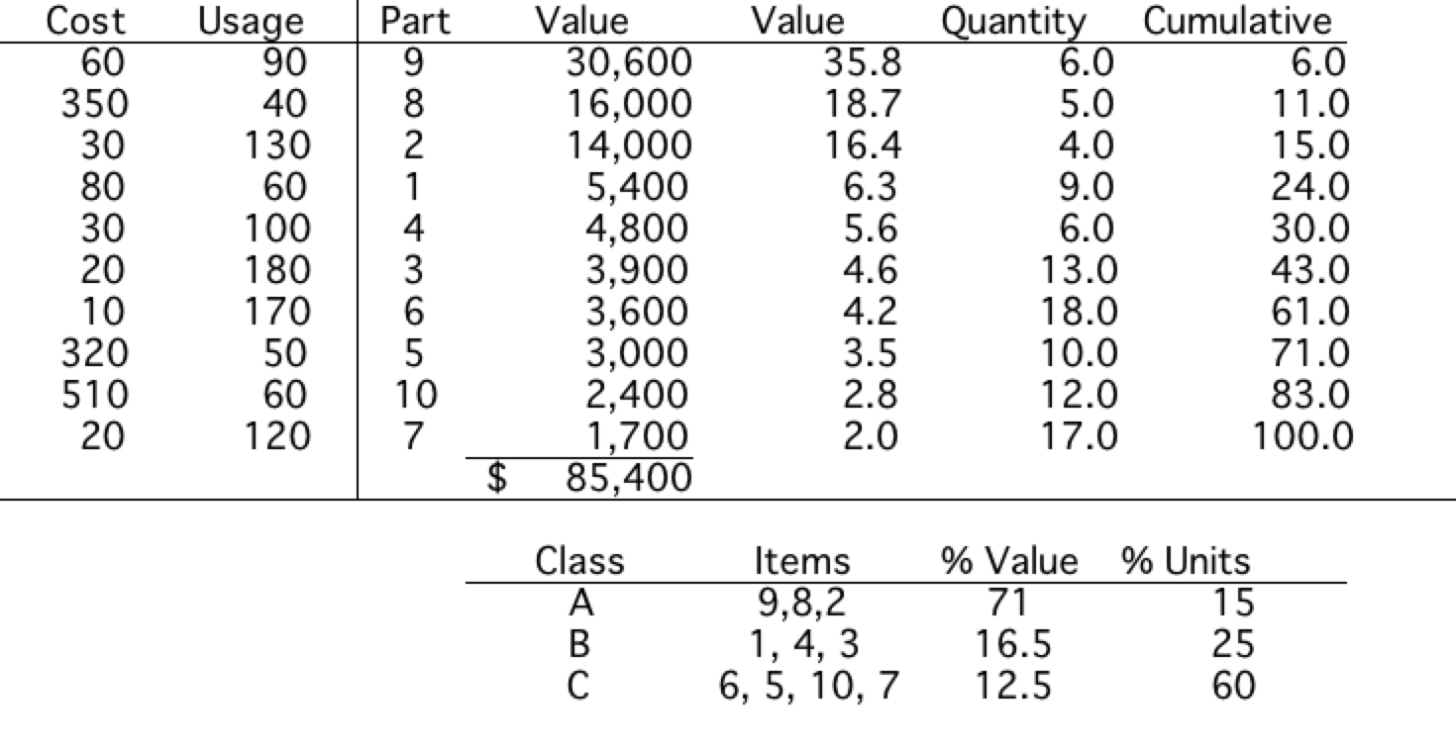
ABC Classification Example

Slide 9
Assumptions Of Basic EOQ Model
Demand is known with certainty
Demand is relatively constant over time
No shortages are allowed
Lead time for the receipt of orders is constant
The order quantity is received all at once

Slide 10
The Inventory Order Cycle
Demand
rate
Order qty, Q
Inventory Level
Reorder point, R
0
Lead
time
Lead
time
Time
Order
Placed
Order
Received
Order
Placed
Order
Received

Slide 11


EOQ Cost Model
C_{O} - cost of placing order D - annual demand
C_{C} - annual per-unit carrying cost Q - order quantity
Annual ordering cost =
Annual carrying cost =
Total cost = +

Slide 12
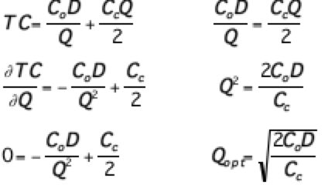
EOQ Model

Slide 13
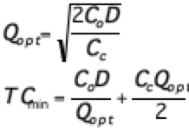
Total Cost at Q*

Slide 14
EOQ Model Cost Curves
Slope = 0
Annual
cost ($)
Total Cost
Minimum
total cost
Carrying Cost = C_{c}Q/2
Ordering Cost = C_{o}D/Q
Optimal order
Q_{opt}
Order Quantity, Q

Slide 15
EOQ Example
C_{C} = $0.75 per yard
C_{O} = $150
D = 10,000 yards
Find EOQ, TC at Q*, # of order/year, and cycle time
NOTE: store days = 311

Slide 16
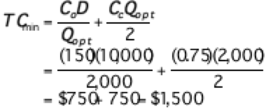
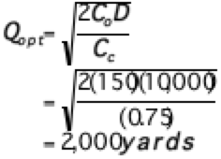
EOQ Example

Slide 17
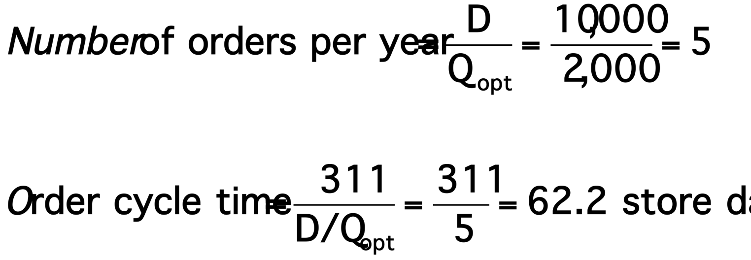
Orders per/yr and Cycle Time

Slide 18
EOQ With
Noninstantaneous Receipt
Inventory
level
Maximum
inventory level
Q(1-d/p)
Begin
Order
receipt
Average
inventory level
Q
2
(1-d/p)
0
End
Order
receipt
Time
Order
receipt period

Slide 19
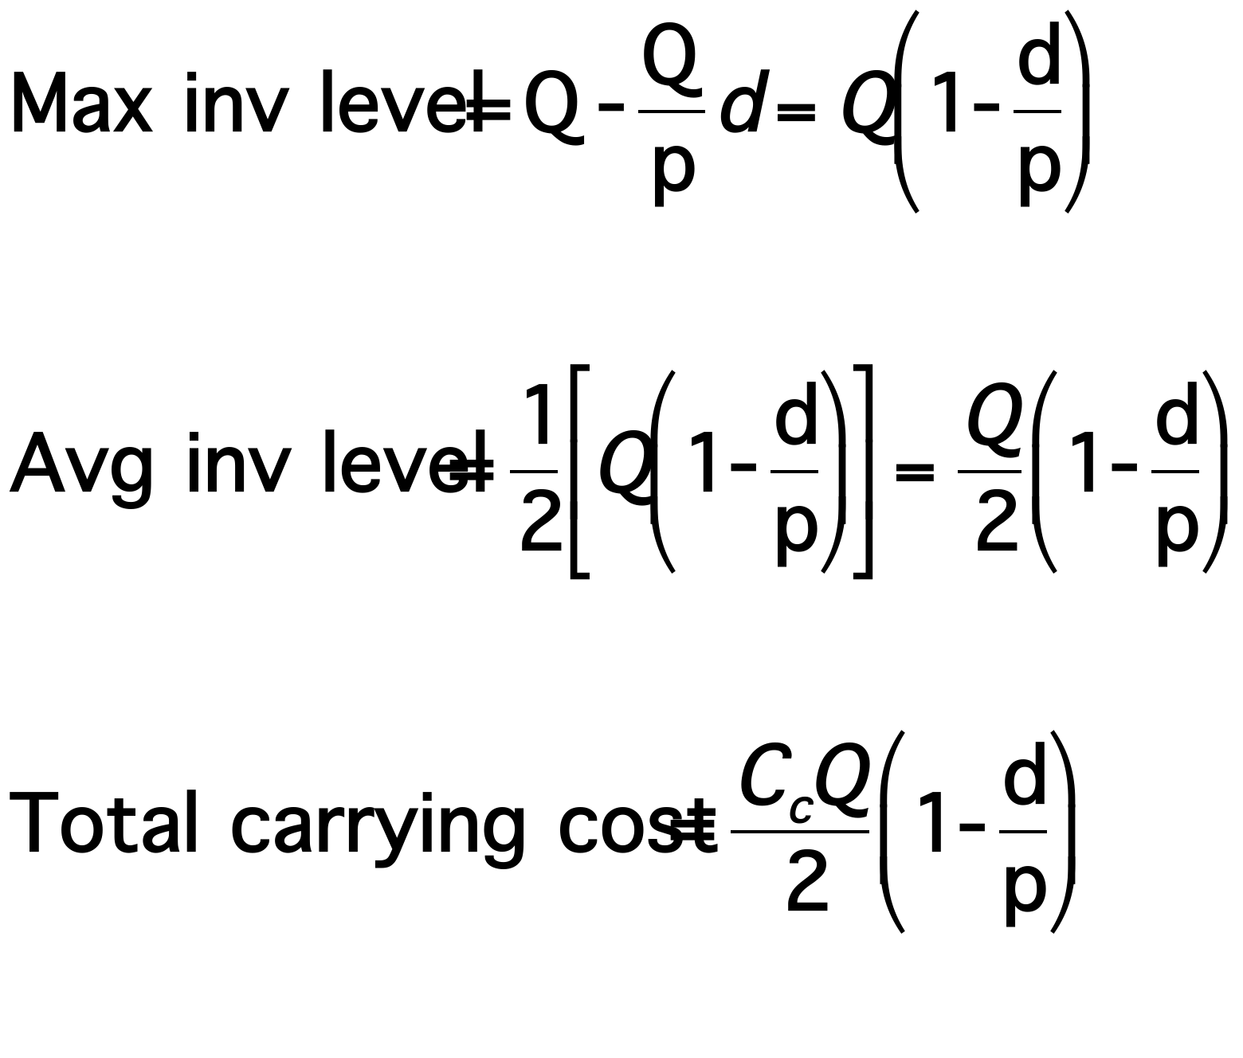
EOQ With
Noninstantaneous Receipt
p = production rate
d = demand rate

Slide 20
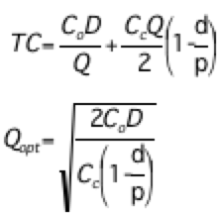
EOQ With
Noninstantaneous Receipt

Slide 21
Production Quantity Example
C_{C} = $0.75 per yard
C_{O} = $150
D = 10,000 yards
d = 10,000/311 = 32.2 yards per day
p = 150 yards per day

Slide 22
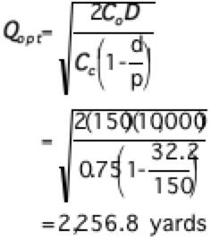
Optimum Q - Q*

Slide 23
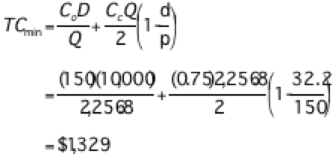
Total Cost

Slide 24

Production Run and Max Inv. Levels
Production run = Q/p
= 2,256.8/150
= 15.05 yards
Number of production runs = D/Q
= 10,000/2,256.8
= 4.43

Slide 25
Safety Stocks
Safety stock
  buffer added to on hand inventory during lead time
Stockout
  an inventory shortage
Service level
  probability that the inventory available during lead time will meet demand

Slide 26
Inputs and Outputs to Aggregate Production Planning
Capacity
Constraints
Strategic
Objectives
Company
Policies
Demand
Forecasts
Financial
Constraints
Aggregate
Production
Planning
Size of
Workforce
Units or dollars
subcontracted,
backordered, or
lost
Production
per month
(in units or $)
Inventory
Levels

Slide 27
Hierarchical Planning Process
Items
Production Planning
Capacity Planning
Resource level
Product lines or families
Aggregate
Resource
Production Plan
Requirements Plan
Plants
Individual products
Master Production
Rough-Cut
Critical work centers
Schedule
Capacity Plan
Material
Capacity
All work centers
Components
Requirements Plan
Requirements Plan
Manufacturing operations
Shop Floor
Input/Output
Individual machines
Schedule
Control

