Slide 1
Forecasting & Aggregate Production Planning
Strategic Role Of Forecasting
Forecasting Methods
Capacity Planning
Aggregate Production Planning

Slide 2
Forecasting
Predicting future events
Usually demand behavior over a time frame
Qualitative methods
based on subjective methods
Quantitative methods
based on mathematical formulas

Slide 3
Strategic Role Of Forecasting
Forecasts determine product demand & inventory requirements
Continuous replenishment systems require accurate short-term forecasts
Forecasting crucial to successful TQM
Strategic planning requires forecasting

Slide 4
Components Of Forecasting Demand
Time Frame
daily, weekly monthly forecasts of sales data, up to 2 years into the future
strategic planning of goals, products, markets, planning beyond 2 years into the future
Demand Behavior
trends, cycles, seasonal patterns, random

Slide 5
Forms Of Forecast Movement
Cycle
Trend
Demand
Demand
Random
movement
Time
Time
Seasonal
pattern
Demand
Demand
Trend with
seasonal pattern
Time
Time

Slide 6
Forecasting Methods
Qualitative methods
management judgment, expertise, opinion
use management, marketing, purchasing, engineering
Delphi method
solicit forecasts from experts

Slide 7
Time Series Methods
Statistical methods using historical data
moving average
exponential smoothing
linear trend line
Assume patterns will repeat
Naive forecasts
forecast = data from last period

Slide 8
Moving Average
Average several periods of data
Dampen, smooth out changes
Use when demand is stable with no trend or seasonal pattern
n
S
D_{i}
MA_{n} =
i = 1
n
where,
n = number of periods in
moving average
D_{i} = demand in period i

Slide 9
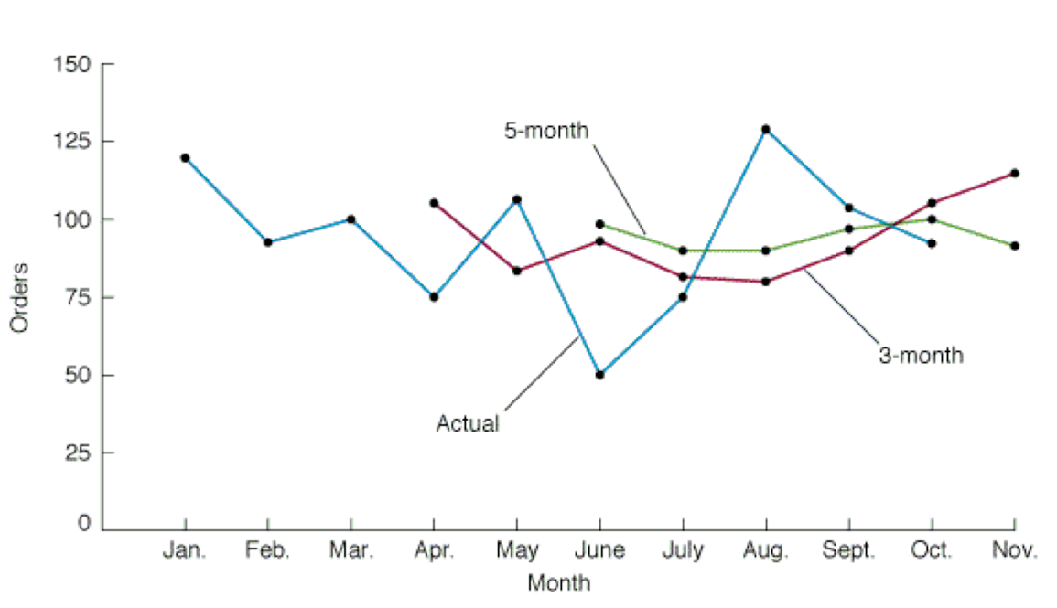
Smoothing Effects
Longer-period moving averages react more slowly

Slide 10
Weighted Moving Average
Adjusts moving average method to more closely reflect data fluctuations
Σ
W_{i} D_{i}
WMA_{n} =
i = 1
where,
W_{i} = the weight for period i,
between 0 and 100 percent
Σ W_{i} = 1.00

Slide 11
Exponential Smoothing
Averaging method
Weights most recent data more strongly
Reacts more to recent changes
Widely used, accurate method
F_{t+1} = αD_{t} + (1 - α)F_{t}
where,
F_{t+1} = forecast for next period
D_{t} = actual demand for present period
F_{t} = previously determined forecast for present period
α = weighting factor, smoothing constant

Slide 12
Effect Of Smoothing Constant
0.0 <= α <= 1.0
If α = 0.20, then F_{t+1} = 0.20 D_{t} + 0.80 F_{t}
If α = 0, then F_{t+1} = 0 D_{t} + 1 F_{t} 0 = F_{t}
Forecast does not reflect recent data
If α = 1, then F_{t+1} = 1 D_{t} + 0 F_{t} = D_{t}
Forecast based only on most recent data

Slide 13
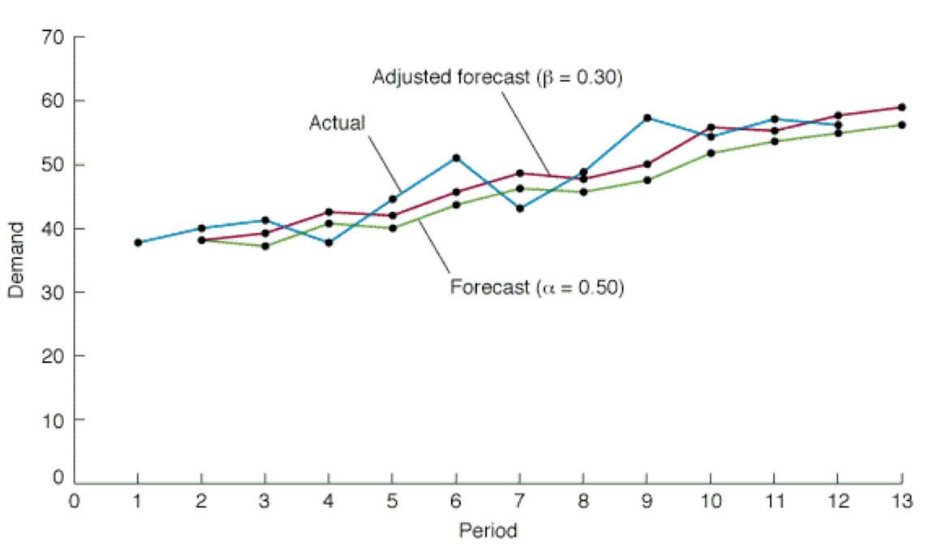
Exponential Smoothing Forecasts

Slide 14
Forecast Accuracy
Error = Actual - Forecast
Find a method which minimizes error
Mean Absolute Deviation (MAD)
Mean Absolute Percent Deviation (MAPD)
Cumulative Error (E)

Slide 15
Forecast Control
Reasons for out-of-control forecasts
change in trend
appearance of cycle
politics
weather changes
promotions

Slide 16
Regression Methods
Study relationship between two or more variables
Dependent variable depends on independent variable

Slide 17
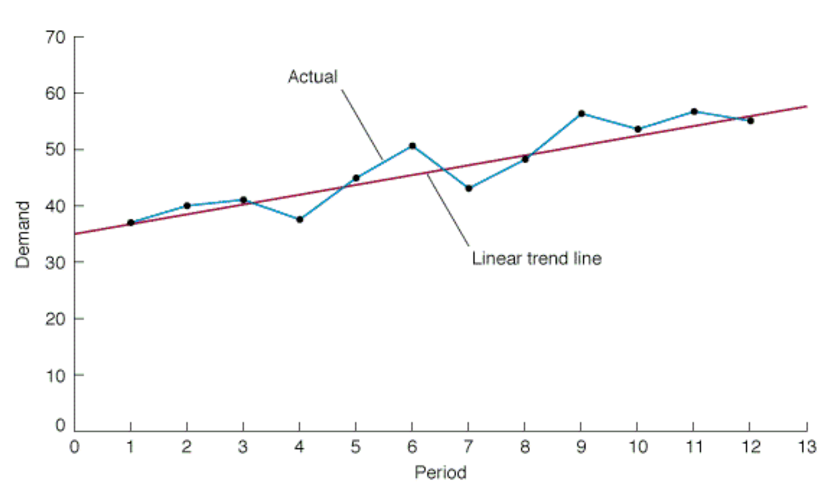
Example Linear Trend Line

Slide 18
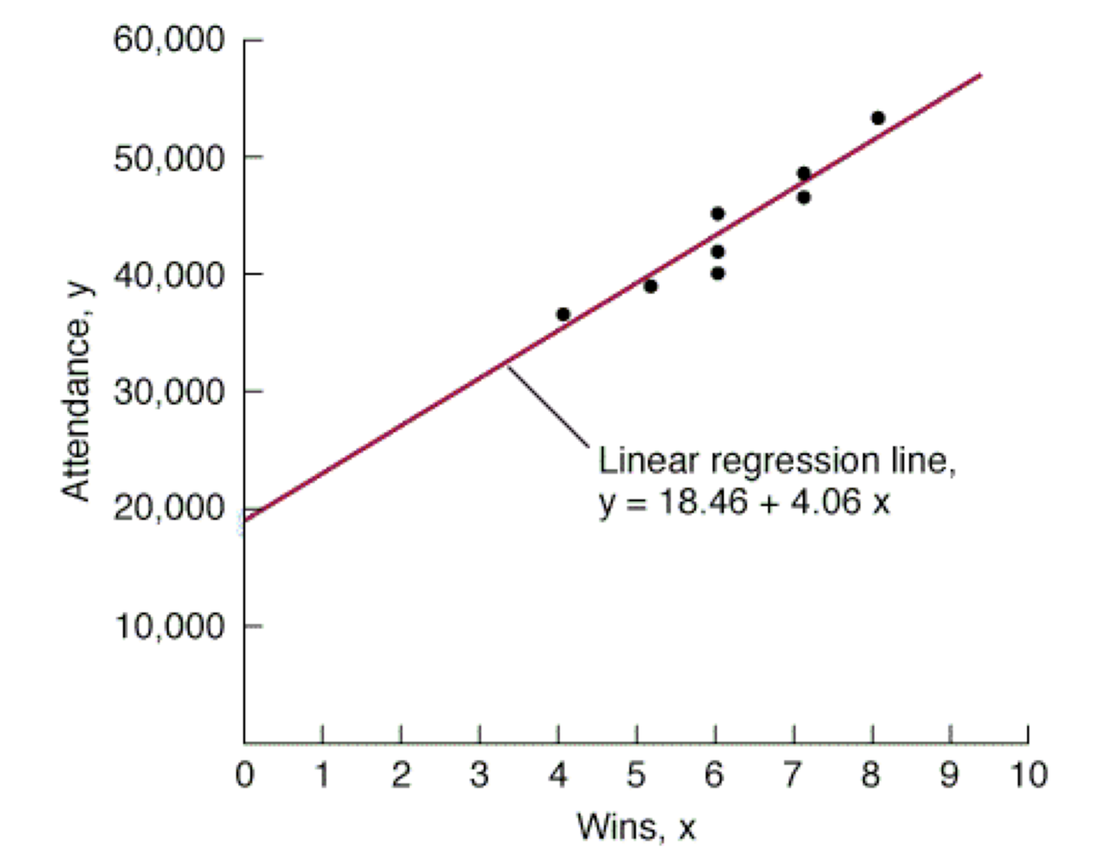
Linear Regression Line

Slide 19
Correlation And Coefficient Of Determination
Correlation, r
measure of strength of relationship
varies between -1.00 and +1.00
Coefficient of determination, r²
percentage of variation in dependent variable
resulting form independent variable

Slide 20
Multiple Regression
Study relationship of demand to two or more independent variables,
y = β₀ + β₁ x₁ + β₂ x₂ +…. + β_{k} x_{k}
where,
β₀ = intercept
β₁,..., β_{k} = parameters for independent variables
x₁ ,..., x_{k} = independent variables

Slide 21
Capacity Planning
Establishes overall level of productive resources
Affects leadtime responsiveness, cost & competitiveness
Determines when and how much to increase capacity
Notes:
2
Capacity lead strategy
expand capacity in anticipation of growth
Capacity lag strategy
increase capacity after increase in growth
Average capacity strategy
expand capacity to coincide with average demand

Slide 22
Capacity Expansion
Volume & certainty of anticipated demand
Strategic objectives for growth
Costs of expansion & operation
Incremental or one-step expansion

Slide 23
Capacity Expansion Strategies
Capacity lead strategy
Capacity lag strategy
Units
Units
Capacity
Demand
Demand
Capacity
Time
Time
Average capacity strategy
Incremental vs. one-step expansion
Units
Units
Capacity
One-step
expansion
Incremental
expansion
Demand
Demand
Time
Time

Slide 24
Best Operating Levels With Economies & Diseconomies Of Scale
250
room
hotel
1000
room
hotel
500
room
hotel
Average cost per unit
Best
operating
level
Best
operating
level
Best
operating
level
Economies of scale
Diseconomies of scale

Slide 25
Aggregate Production Planning (APP)
Matches market demand to company resources
Plans production 6 months to 12 months in advance
Expresses demand, resources, and capacity in general terms
Develops a strategy for economically meeting demand
Establishes a companywide game plan for allocating resources

Slide 26
Inputs and Outputs to Aggregate Production Planning
Capacity
Constraints
Strategic
Objectives
Company
Policies
Demand
Forecasts
Financial
Constraints
Aggregate
Production
Planning
Size of
Workforce
Units or dollars
subcontracted,
backordered, or
lost
Production
per month
(in units or $)
Inventory
Levels

Slide 27
Strategies for Meeting Demand
1. Use inventory to absorb fluctuations in demand (level production)
2. Hire and fire workers to match demand (chase demand)
3. Maintain resources for high demand levels
4. Increase or decrease working hours (over & undertime)
5. Subcontract work to other firms
6. Use part-time workers
7. Provide the service or product at a later time period (backordering)

Slide 28
Strategy Details
Level production - produce at constant rate & use inventory as needed to meet demand
Chase demand - change workforce levels so that production matches demand
Maintaining resources for high demand levels - ensures high levels of customer service
Overtime & undertime - common when demand fluctuations are not extreme

Slide 29
Strategy Details
Subcontracting - useful if supplier meets quality & time requirements
Part-time workers - feasible for unskilled jobs or if labor pool exists
Backordering - only works if customer is willing to wait for product/services

Slide 30
Level Production
Demand
Production
Units
Time

Slide 31
Chase Demand
Demand
Units
Production
Time

Slide 32
APP Using Pure Strategies
Quarter Sales Forecast (lb)
Spring 80,000
Summer 50,000
Fall 120,000
Winter 150,000
Hiring cost = $100 per worker Firing cost = $500 per worker
Inventory carrying cost = $0.50 pound per quarter
Production per employee = 1,000 pounds per quarter
Beginning work force = 100 workers

Slide 33
Level Production Strategy
Sales Production
Quarter Forecast Plan Inventory
Spring 80,000 100,000 20,000
Summer 50,000 100,000 70,000
Fall 120,000 100,000 50,000
Winter 150,000 100,000 0
400,000 140,000
Cost = 140,000 pounds x 0.50 per pound = $70,000

Slide 34
Chase Demand Strategy
Sales Production Workers Workers Workers
Quarter Forecast Plan Needed Hired Fired
Spring 80,000 80,000 80 - 20
Summer 50,000 50,000 50 - 30
Fall 120,000 120,000 120 70 -
Winter 150,000 150,000 150 30 -
100 50
Cost = (100 workers hired x $100) + (50 workers fired x $500)
= $10,000 + 25,000 = $35,000

Slide 35
Other Quantitative Techniques
Linear programming
Linear decision rule (LDR)
Search decision rule (SDR)
Management coefficients model
Notes:
20
Linear decision rule (LDR)
payroll, staffing, over/undertime, inventory costs
Search decision rule (SDR)
find minimum cost combination of labor levels & production rates
Management coefficients model
uses regression analysis to improve consistency of planning

Slide 36
Strategies for Managing Demand
Shift demand into other periods
incentives, sales promotions, advertising campaigns
Offer product or services with countercyclical demand patterns
create demand for idle resources

Slide 37
Hierarchical Planning Process
Items
Production Planning
Capacity Planning
Resource level
Product lines or families
Aggregate
Resource
Production Plan
Requirements Plan
Plants
Individual products
Master Production
Rough-Cut
Critical work centers
Schedule
Capacity Plan
Material
Capacity
All work centers
Components
Requirements Plan
Requirements Plan
Manufacturing operations
Shop Floor
Input/Output
Individual machines
Schedule
Control

Slide 38
Aggregate Planning for Services
1. Most services can’t be inventoried
2. Demand for services is difficult to predict
3. Capacity is also difficult to predict
4. Service capacity must be provided at the appropriate place and time
5. Labor is usually the most constraining resource for services

