Slide 1
Facility Layout
Objectives of Facility Layout
Basic Types
Service Process Layout
Product Layout
Product vs. Process Layouts
Designing Process Layouts
Designing Product Layouts
Product Layouts & Line Balancing

Slide 2
Objectives of Facility Layout
Minimize material handling costs
Utilize space and labor efficiently
Eliminate bottlenecks
Facilitate communication
Reduce manuf. cycle time or customer service time
Promote product and service quality
& Many others

Slide 3
Basic Types of Layouts
Process Layout
machines grouped by process they perform
Product Layout
linear arrangement of workstations to produce a specific product
Fixed Position Layout
used in projects where the product cannot be moved

Slide 4
Hybrid Layouts
Cellular layouts
group machines into machining cells
Flexible manufacturing systems
automated machining & material handling systems
Mixed-model assembly lines
produce variety of models on one line

Slide 5
Manufacturing Process Layout
Lathe Department
Milling Department
Drilling Department
L
L
M
M
D
D
D
D
L
L
M
M
D
D
D
D
L
L
G
G
G
P
L
L
G
G
G
P
Painting Department
L
L
Grinding Department
A
A
A
Receiving and
Shipping
Assembly

Slide 6
Service Process Layout
Children’s
department
Shoes
Housewares
Women’s
dresses
Cosmetics
& Jewelry
Power Tools
Women’s
sportswear
Entry &
display area
Men’s
department

Slide 7
A Product Layout
IN
OUT

Slide 8
Product vs. Process Layouts
PRODUCT LAYOUT PROCESS LAYOUT
1. Description Sequential arrangement Functional grouping
of machines of machines/areas
2. Type of Continuous, mass Intermittent, job shop,
Process production, assembly batch production
3. Product Standardized, make-to-stock Varied, make-to-order
4. Storage Small Large
(IKEA?)

Slide 9
Designing Process Layouts
Minimize material handling costs
Block Diagramming
minimize nonadjacent loads
use when quantitative data is available
Relationship Diagramming
based on location preference between areas
use when quantitative data is not available

Slide 10
Block Diagramming
Examples in Chapter 8 – pg 168-172
Create load summary chart
Calculate composite (2-way) movements (if necessary)
Develop trial layouts minimizing number of nonadjacent loads (i.e., this means min cost or distance)
Assume nonadjacent loads are 2x (expense or distance)

Slide 11
LOAD SUMMARY CHART($)
DEPARTMENT
DEPT.
1
2
3
4
5
1
100
110
2
200
150
50
3
40
50
4
60
5

Slide 12
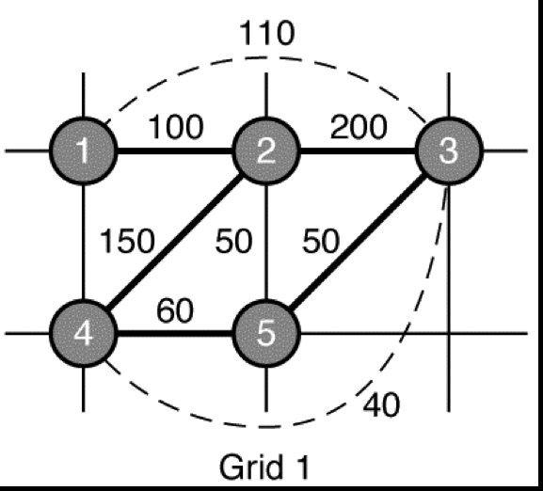
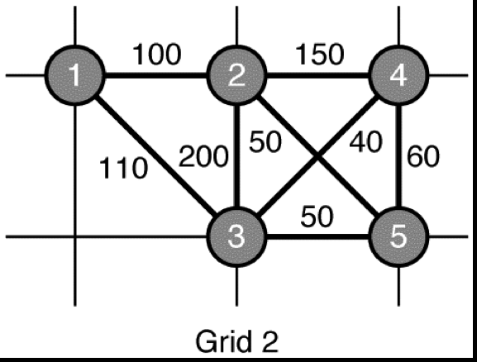
Initial & Final Designs

Slide 13
Relationship Diagramming
Used when quantitative data is not available
Muther’s grid displays preferences
Denote location preferences with weighted lines

Slide 14
Ranking System For Departments
A - absolutely necessary
E - especially important
I - important
O - okay
U - unimportant
X - undesirable

Slide 15
Relationship Diagramming Example
Production
O
Offices
A
U
I
Stockroom
O
E
A
X
A
Shipping and Receiving
U
U
U
O
Locker Room
O
O
Toolroom

Slide 16
Service Layouts
Usually process layouts
Minimize flow of customers or paperwork
Retailing tries to maximize customer exposure to products
Computer programs consider shelf space, demand, profitability
Layouts must be aesthetically pleasing

Slide 17
Designing Product Layouts (assembly lines)
Precedence diagram
network showing order of tasks and restrictions on their performance
Cycle time
maximum time product can spend at any one workstation; largest workstation time; how often a product is completed
Example in Chapter 8 – pg 175-177

Slide 18
Product Layouts & Line Balancing
1. Draw and label a precedence diagram
2. Calculate desired cycle time
3. Calculate theoretical min # of workstations
4. Group elements into the minimum # of workstations recognizing cycle time and precedence constraints
5. Calculate efficiency of the line
6. Stop if desired efficiency or # workstations; else go to step 4

Slide 19
Drawing A Precedence Diagram
Work element Precedence time
Press out sheet of fruit - 0.1
Cut into strips A 0.2
Outline fun shapes A 0.4
Roll up and package B, C 0.3
B
0.2
0.1
A
D
0.3
C
0.4

Slide 20
Computing Cycle Time
Maximum time product can spend at any station
production time available
desired output
C =
What cycle time do we need to produce
6,000 units in a 40 hour week?
40 x 60
6,000
C =
= 0.4

Slide 21
Flow Time vs. Cycle Time
Flow time = time to complete all stations
Cycle time = max time spent at any station
B
0.2
Flow time = 0.1 + 0.2 + 0.4 + 0.3
= 1.0
Cycle time = max (0.1, 0.2, 0.4,0.3) = 0.4
0.1
A
D
0.3
C
0.4
0.1, 0.2
0.4
0.3

Slide 22
Balancing The Line - Straight Line
Workstation Task Remaining time Feasible tasks
1 A 0.3 B
B 0.1 none
2 C 0.0 none
3 D 0.1
1
2
3
A, B
C
D
0.3 min
0.4 min
0.3 min

Slide 23
Calculating Efficiency

