Slide 1
Process Planning And Technology
Process Strategy
Process Planning
Make-Or-Buy Decisions
Process & Specific Equipment Selection
Process Analysis
Information Technology
Manufacturing Technology

Slide 2
Process Strategy
Approach to producing goods &services
Process strategy defines
  Capital intensity & investment
  Process flexibility
  Vertical integration
  Customer involvement

Slide 3
Process Planning
Make-or-buy decisions
Process & specific equipment selection
Process plans & process analysis

Slide 4
Make-Or-Buy Decisions
1. Cost
2. Capacity
3. Quality
4. Speed
5. Reliability
6. Expertise

Slide 5
Process & Specific Equipment Selection
1. Purchase cost - basic price, installation, programming, support
2. Operating cost - $ assoc. with operation, maintenance, repair, etc.
3. Annual savings - $ saved from less: labor, material, rework & scrap
4. Revenue enhancement - improved quality, lower cost, more flexible
5. Replacement & risk analysis - salvage value, replacement cycle, expected life, operating cost, risk-adjusted hurdle rates

Slide 6
Process Analysis
Process flowchart and Process Maps
  Standardized method for documenting steps in a process
  Quality control and certification
  Continuous improvement
  Process maps are higher level
Gantt Chart
  Project management
  Time management

Slide 7
Information Technology
Management information systems (MIS)
Decision support systems (DSS)
Expert systems (ES)
Artificial Intelligence (AI)
  Neural networks
  Genetic algorithms
  Fuzzy logic

Slide 8
Manufacturing Technology
Numerically controlled (NC) machines
  used in cutting, boring, sawing, sewing, etc.
Flexible Manufacturing Systems (FMS)
  Networked computer/machine system providing easy changes, reducing setup & queue times, improving quality
Computer Integrated Manufacturing (CIM)
  Integration of design, manufacture & delivery via computer technology (CAD, CAM, CASE, etc.)

Slide 9
Process Selection w/ Break-Even Analysis
For a single process,
  find the breakeven point
Among several processes,
  find the point of indifference

Slide 10
Break-Even Analysis
Total cost = total fixed cost + total variable cost
TC = c_{f} + vc_{v}
Total revenue = volume x price
TR = vp
Total profit = total revenue - total cost
Z = TR - TC = vp - (c_{f} + vc_{v})
where,
c_{f} = fixed cost, v = volume,
c_{v} = variable cost per unit, p =price per unit

Slide 11
Solving For Break-Even Point
TR = TC
vp = (c_{f} + vc_{v})
vp - vc_{v} = c_{f}
v(p - c_{v}) = c_{f}
v =
c_{f}
p - c_{v}

Slide 12
Break-Even Example
Fixed cost c_{f} = $2,000
Variable cost c_{v} = $5 per raft
Price p = $10 per raft
v = =
c_{f}
p - c_{v}
2000
10 - 5
= 400 rafts

Slide 13
Break-Even Graph
$5,000
$4,000
TC
Dollars
$3,000
$2,000
TR
$1,000
$0
Units
400
Break even point

Slide 14
Choosing Between Two Processes
Find volume where
  Cost of process A = Cost of process B
Above point of indifference, choose process with lowest variable cost
Below point of indifference, choose process with lowest fixed cost

Slide 15
Point Of Indifference
Process A Process B
$2,000 + $5v = $10,000 + $2v
$3v = $8,000
v = 2,667 rafts
Below 2,667 rafts, choose A
Above 2,667 rafts, choose B

Slide 16
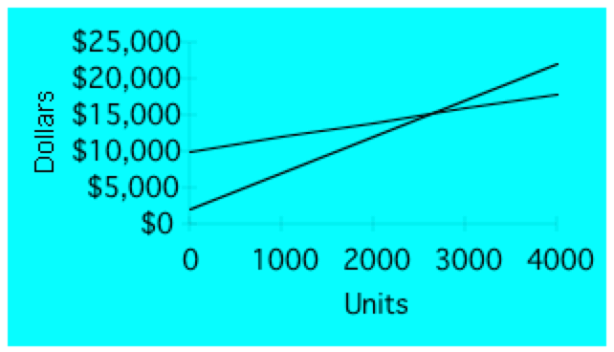
Graphical Solution to
Process Selection
B
A

