Slide 1
Product and Service Design
Product and Service Design
Process Planning
Concurrent Design and Engineering
Functional Design
Reliability and Analyzing Failures
Design Process
Quality Function Deployment
Taguchi Robust Design

Slide 2
Product Design
Specifies materials
Determines dimensions & tolerances
Defines appearance
Sets performance standards

Slide 3
Service Design
Specifies what the customer is to experience
Determines setting and degree of customer involvement
Defines physical items, physiological benefits, & psychological benefits the customer receives
Sets standards for delivery

Slide 4
An Effective Design Process
Matches product/service characteristics with customer needs
Meets customer requirements in the simplest, most cost-effective manner
Reduces time to market
Minimizes revisions

Slide 5
Feasibility Study
Market Analysis
Economic Analysis
Technical / Strategic Analysis

Slide 6
Perceptual Map Of Breakfast Cereals
Good taste
Cocoa Puffs
Low nutrition
High nutrition
Cheerios
Rice
Krispies
Wheaties
Shredded
Wheat
Bad taste
Notes:
Figure 5.3

Slide 7
Process Planning
Create workable instructions for manufacture
Select tooling & equipment
Prepare job descriptions
Determine operation & assembly order
Network all systems

Slide 8
Improving The Design Process
1. Implementing concurrent engineering/design and design teams
2. Analyzing functional design, reliability, and maintainability
3. Measuring design quality
4. Utilizing quality function deployment
5. Designing for robustness

Slide 9
Concurrent Design
Also known as simultaneous or concurrent engineering
Simultaneous decision making by design teams
Integrates product design & process planning
Details of design more decentralized
Encourages price-minus, not cost-plus pricing
Needs careful scheduling because tasks are done in parallel

Slide 10
Concurrent Design
Customers
Design
Marketing
Engineering
Suppliers
Production

Slide 11
Design Teams
Cross-functional
  Marketing, manufacturing, engineering, finance
Vertical
  Suppliers, dealers, customers
Horizontal
  Lawyers, accountants, insurance companies

Slide 12




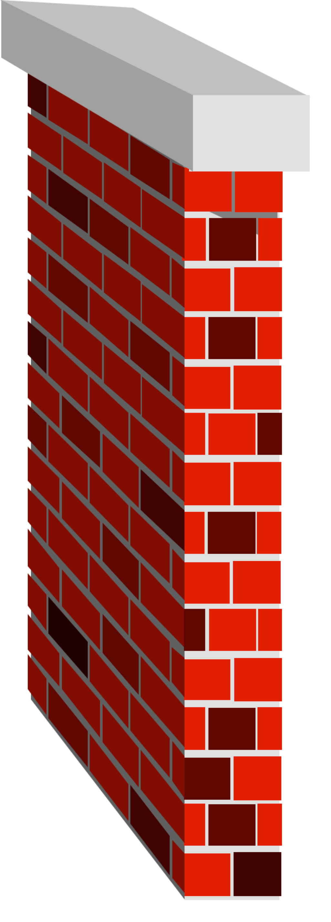
Customers
Marketing
Design
Engineers
Manuf.
Engineers
Production
Break Down the Walls Between
Functional Areas
Notes:
Figure 5.1

Slide 13
Functional Design
(How The Product Performs)
Reliability
  probability product performs intended function for specified length of time
Maintainability
  ease and/or cost or maintaining/repairing product

Slide 14
Analyzing Failures
Failure Mode and Effects Analysis (FMEA)
  a systematic approach for analyzing causes and effects of failures
  prioritizes failures
  attempts to eliminate causes
Fault Tree Analysis (FTA)
  more visual
  studies interrelationship between failures

Slide 15
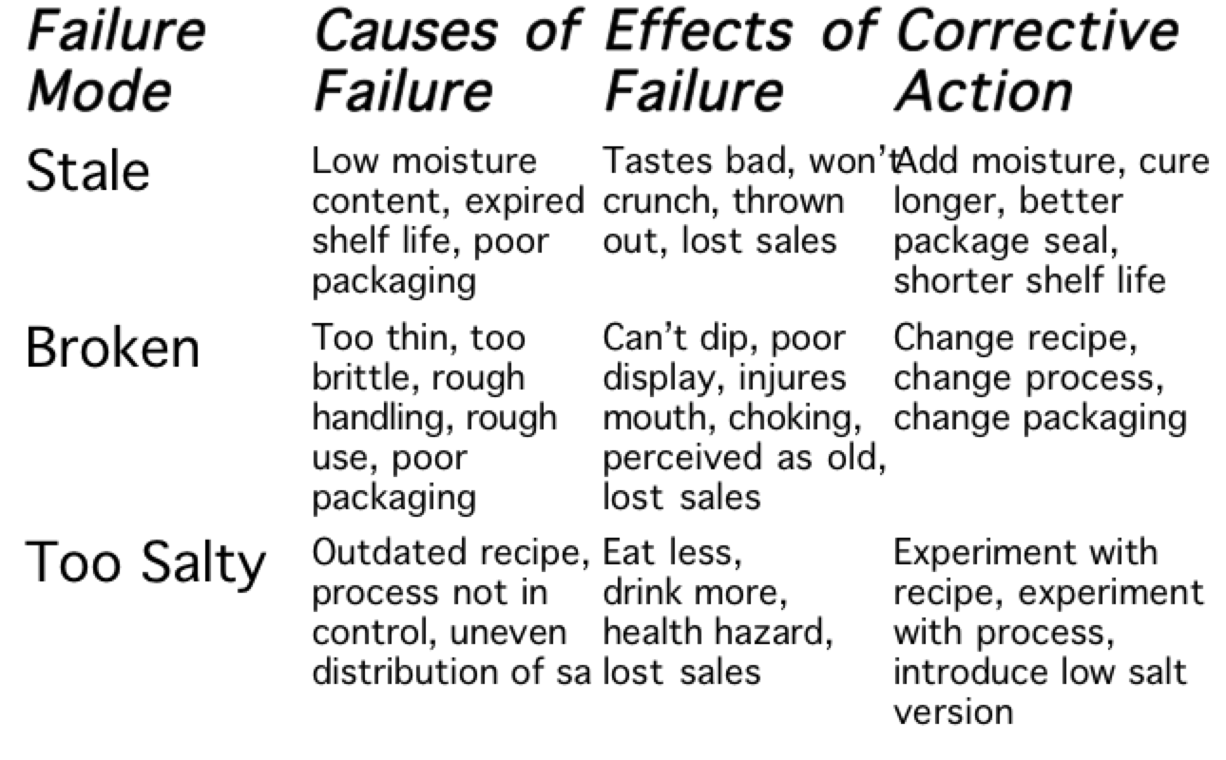
Failure Mode & Effects Analysis

Slide 16
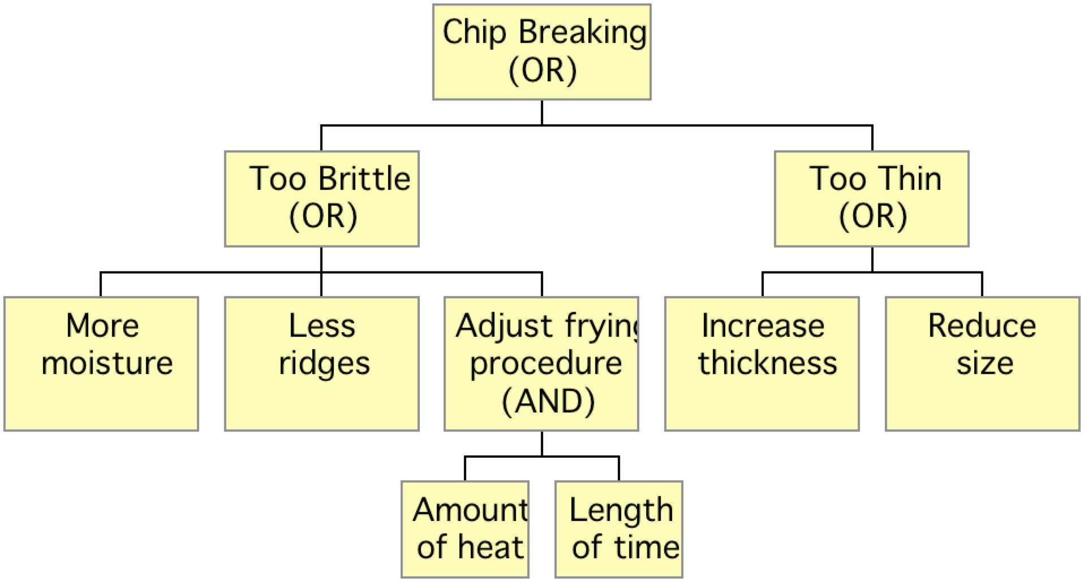
Fault Tree Analysis
Solved
Solved

Slide 17
Computing Reliability
Components in series
0.90
0.90
0.90 x 0.90 = 0.81
Components in parallel
.90
.95
0.95 + 0.90(1-0.95) = 0.995

Slide 18
Quality Function Deployment (QFD)
Translates the voice of the customer into technical design requirements
Displays requirements in matrix diagrams
First matrix called house of quality
Series of connected houses

Slide 19
House Of Quality
5. Tradeoff
Matrix
3. Product
characteristics
Importance
1. Customer
requirements
4. Relationship
matrix
2. Competitive
assessment
6. Technical assessment and
target values

Slide 20
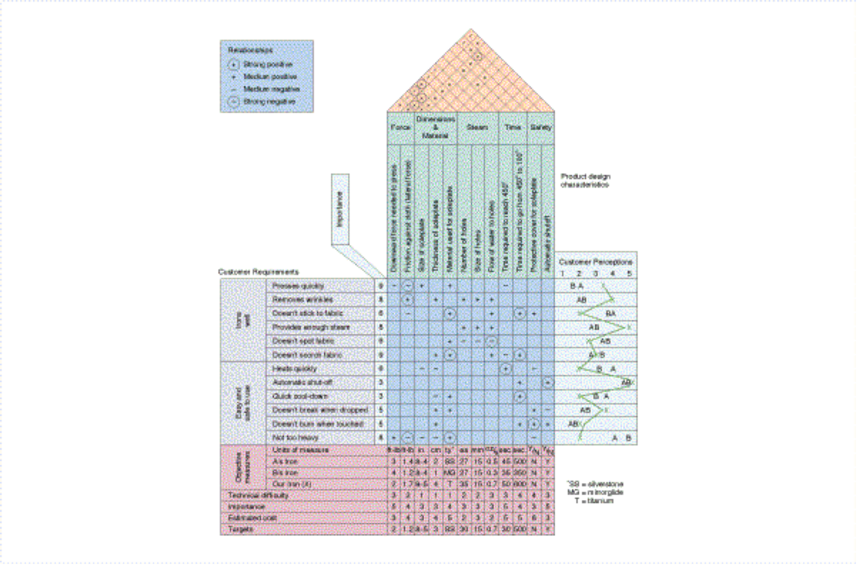
House Of Quality for a Steam Iron

Slide 21
Series of Connected Houses
Customer
Req.
Product
Characteristics
A-1
Part
Characteristics
House of
Quality
A-2
Process
Characteristics
A-3
Parts
Deployment
Operations
A-4
Process
Planning
Operating
Requirements

Slide 22
Benefits Of QFD
Promotes better understanding of customer demands and design interactions
Increases customer satisfaction
Breaks down barriers between functions & departments & fosters teamwork
Improves design/development process documentation
Reduces the # of engineering changes, cost of design & manufacture, and brings new designs to the market faster

Slide 23
Taguchi’s Robust Design
A product or service exhibits robustness if it performs consistently regardless of the operating conditions
Designers must consider both controllable factors (design features) and uncontrollable factors (operating conditions) in design for robustness

Slide 24
Consistency Is Important
Consistent errors are easier to correct than random errors
Parts within tolerances may yield assemblies which aren’t within tolerances
Consumers prefer product characteristics near their ideal values

Slide 25
Taguchi’s Quality Loss Function
Quality Loss
Lower
Tolerance
Limit
Target
Upper
Tolerance
Limit

