Slide 1
Operations, Competitiveness, and Strategy
Strategic Planning
Mission &
Vision
Voice of the
Business
Voice of the
Business
Strategy
Customer
Marketing
Operations
Financial
Strategy
Strategy
Strategy

Slide 2
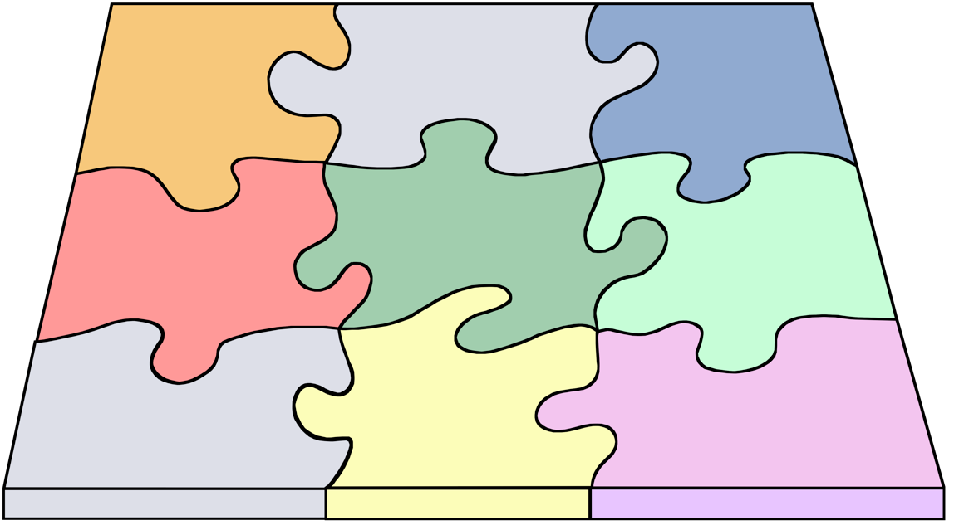
Definition of Quality
Process
and
Technology
Products
Services
Human
Resources
Capacity
Quality
Facilities
Sourcing
Operating
Systems

Slide 3
Products & Services
Make-to-order
  make to customer specifications after order is received
Make-to-stock
  make in anticipation of demand
Assemble-to-order
  add options according to customer specifications

Slide 4
Processes & Technology
Project
  produce a product or service one-at-a-time to customer order
Batch production
  process many different jobs at the same time in batches
Mass production
  produce large volumes of a standard product or service for a mass market
Continuous production
  produce a commodity product or service continuously in very high volume

Slide 5
Product-Process Matrix
High
Continuous
production
Mass
production
Volume
Batch
production
Standardization
Projects
Low
Low
High
Notes:
The product-process matrix matches product characteristics with process choice. The most important product characteristics in terms of process choice are degree of standardization and demand volume. The best process strategy is found on the diagonal of the matrix.

Slide 6
Capacity
Level of capacity
Size of capacity changes
Handling excess demand
Hiring/firing workers
Need for new facilities
Notes:
Strategic issues in terms of capacity

Slide 7
Facilities
Best size for facility
Large or small facilities
Facility focus
Facility location
Global facility
Notes:
Capacity decisions lead to facility decisions.

Slide 8
Human Resources
Skill levels required
Degree of autonomy
Policies
Profit sharing
Individual or team work
Type of supervision
Levels of management
Training
Notes:
Strategic issues in human resources

Slide 9
Quality
Target level
Measurement
Employee involvement
Training
Systems needed to ensure quality
Maintaining quality awareness
Evaluating quality efforts
Determining customer perceptions
Notes:
Quality permeates virtually every strategic decision.

Slide 10
Sourcing
Degree of vertical integration
Supplier selection
Supplier relationship
Supplier quality
Supplier cooperation
Notes:
Sourcing has become an important strategic decision referred to more generally as supply chain management. The term supply chain refers to the entire logistical chain, linking together the sourcing decisions of a firm, its suppliers, and its suppliersísuppliers from the ultimate source to the final customer.

Slide 11
Operating Systems
Daily execution of strategy
Information technology support
Effective planning & control systems
Alignment of inventory levels, scheduling priorities, & reward systems
Notes:
Operating systems execute strategic decisions on a day-to-day basis, so it is especially important that they be designed to support how the firm competes in the markerplace.

