Slide 1
Inventory Fundamentals
What is inventory?
  Materials & supplies that a business carries either for sale or to provide inputs to the production process
  Those stocks or items used to support production (raw materials and WIP), supporting activities (maintenance, repair, & operating supplies), & customer service (finished goods & spare parts) - APICS Dictionary

Slide 2
Inventory Fundamentals
Can production be planned w/o managing inventory? Not really….
  since inventory either results from production or supports it, the two cannot be managed separately separately & must be coordinated
    Production planning is concerned with overall inventory
    Master planning is concerned with end items
    Material requirements planning is concerned with component parts & raw material

Slide 3
Aggregate Inventory Management
Aggregate inventory management (AIM) is concerned with managing inventories according to their classifications (raw material, work-in-process, finished goods, etc.) & the function they perform
AIM is financially oriented & concerned w/ costs & benefits of carrying the classifications of inventories

Slide 4
Aggregate Inventory Management
AIM involves
  Flow & kind of inventory needed
  Supply & demand patterns
  Functions inventory performs
  Objectives of inventory management
  Costs associated w/ inventory

Slide 5
Item Inventory Management
Decision rules must be established about individual inventory items:
  Importance of inventory items
  How they are to be controlled
  How much to order at one time
  When to place an order

Slide 6
Inventory & Flow of Materials
Inventory can be classified according to the following flow:
  Raw material
  Work-in-process (WIP)
  Raw & In-Process (RIP)
  Finished goods
  Distribution
  Maintenance, repair, and operating supplies (MRO)

Slide 7
Inventory & Flow of Materials
Raw materials - purchased materials, component parts, & subassemblies
Work-in-process (WIP) - materials that have entered the manufacturing process & are being worked on or waiting to be worked on
Raw and in-process (RIP) - raw materials or work-in-process, a term used in JIT to account for shipments to point-of-use

Slide 8
Inventory & Flow of Materials
Finished goods - finished products of the production process that are ready to be sold as completed items
Distribution inventories - finished goods located in the distribution system
Maintenance, repair, & operational supplies (MROs) - items used in production that do not become part of the product

Slide 9
Functions of Inventories
Inventory serves as a buffer between:
  supply & demand
  customer demand & finished goods
  finished goods & component availability
  requirements for an operation & the output from the preceding operation
  parts & materials to begin production and the supplies of materials

Slide 10
Anticipation Inventory
Anticipation inventory - to anticipate future demand, built up to help level production & to reduce costs of changing production rates
  e.g.,
    created ahead of a peak selling season, a promotion program, vacation shutdown, or possibly a strike

Slide 11
Safety Stock
Purposes of inventory (continued)
  Fluctuation inventory covers random fluctuations in supply & demand or lead time (commonly called safety stock)
  Prevents disruptions in manufacturing or deliveries to customers

Slide 12
Lot-Size Inventory
Lot-size inventory - to purchase or manufacture in quantities greater than needed immediately
  Takes advantage of quantity discounts, to reduce shipping, clerical, & setup costs, & in cases where it is impossible to make or purchase items at the same rate they will be used or sold

Slide 13
Transportation & Hedge Inventory
  Transportation inventory covers the time needed to move goods from one location to another (sometimes called pipeline inventory)
  Hedge inventory protect against price fluctuations

Slide 14
Inventory Objectives
Inventories must be coordinated to meet three conflicting objectives:
  Maximize customer service
  Minimize plant operation costs
  Minimize inventory investment

Slide 15
Inventory Costs
Inventory management costs
  Item costs
  Carrying costs
  Ordering costs
  Stockout costs
  Capacity-related costs

Slide 16
Inventory Costs
Item costs include cost of item & all costs to get item to facility
    product
    transportation
    customs duties
    insurance
    direct material, direct labor, and factory overhead

Slide 17
Inventory Carrying Costs
Carrying costs include all costs caused by amount of inventory carried; 3 categories used are:
    Capital costs
      money tied up in inventory
    Storage costs
      space, personnel, and equipment
    Risk costs
      Obsolescence, damage, pilferage, insurance, and deterioration

Slide 18
Inventory Carrying Costs
The annual carrying costs depend on the average inventory carried (i.e., the more that is ordered at one time, the higher the average inventory)
The annual cost of carrying inventory can be decreased by ordering less at one time

Slide 19
Inventory Ordering Costs
Ordering costs - include costs of placing an order & include:
    Production control costs
    Setup and teardown costs
    Lost capacity costs
      Every time an order is placed on a work center, the time taken to set up is lost as productive output time. It is particularity important with bottleneck operations.
    Purchase order costs

Slide 20
Inventory Ordering Costs
Annual ordering cost depends on the number of orders placed in a year
Annual cost of ordering can be reduced by decreasing the cost of placing an order & by reducing the number of orders placed
Number of orders per year can be reduced by ordering more at any one time

Slide 21
Inventory Costs
Stockout costs occur when demand during lead time exceeds the forecast & available inventory
Possible costs of a stockout include:
    Backorder costs
    Lost sales costs
    Lost customer costs

Slide 22
Inventory Costs
Capacity-related costs are those of changing production levels & include:
    Overtime / slack time
    Hiring
    Layoff
    Training
    Shift premiums

Slide 23
Inventory Turns
Inventory turns: a measure of how effectively inventories are being used
Ratio of Annual Cost of Goods Sold to average inventory in dollars
e.g.,
What will be the inventory turns ratio if the annual cost of goods sold is $24 million and the average inventory is $6 million?
Inventory turns = Annual COGS / Avg. inv. $
= $24 million / $6 million = 4

Slide 24
Inventory Turns Example
What would be the reduction in inventory if inventory turns were increased to 12?
Avg. inv. $ = Annual COGS / Inventory Turns
= $24 million / 12 = $2 million
Reduction = $6 million - $2 million = $4 million
If the carrying cost is 25%, what will the savings be?
Savings = $4 million X 25% = $1 million

Slide 25
ABC Inventory Control
Control of inventory is exercised by controlling individual items called stock-keeping units (SKUs)
An SKU is an individual item in a specific inventory
Four questions must be answered in controlling inventory:
  What is the importance of the inventory item?
  How are they to be controlled?
  How much should be ordered at one time?
  When should an order be placed?

Slide 26
ABC Inventory Control
ABC inventory classification answers the first two questions by determining the importance of items and thus allowing different levels of control based on the importance of items
Factors affecting the importance of an item include annual dollar usage, unit cost, & scarcity of material

Slide 27
ABC Inventory Control
Based on the observation that a small number of items often dominate the results achieved in any situation & represent the most critical values, i.e., the “Pareto” principle or 80/20 rule
ABC inventory control separates the more significant items from the less important
Used to determine the degree & level of control required

Slide 28
ABC Inventory Control Methodology
Calculate the annual dollar usage for each item
List the items according to their annual dollar usage
Calculate the cumulative annual dollar usage & the cumulative percent of items
Group items into an A, B, C classification.

Slide 29
ABC Classification System
Demand volume & value of items vary
Classify inventory into 3 categories
Class % of Units % of Dollars
A 5 - 15 70 - 80
B 30 1515
C 50 - 60 5 - 10

Slide 30
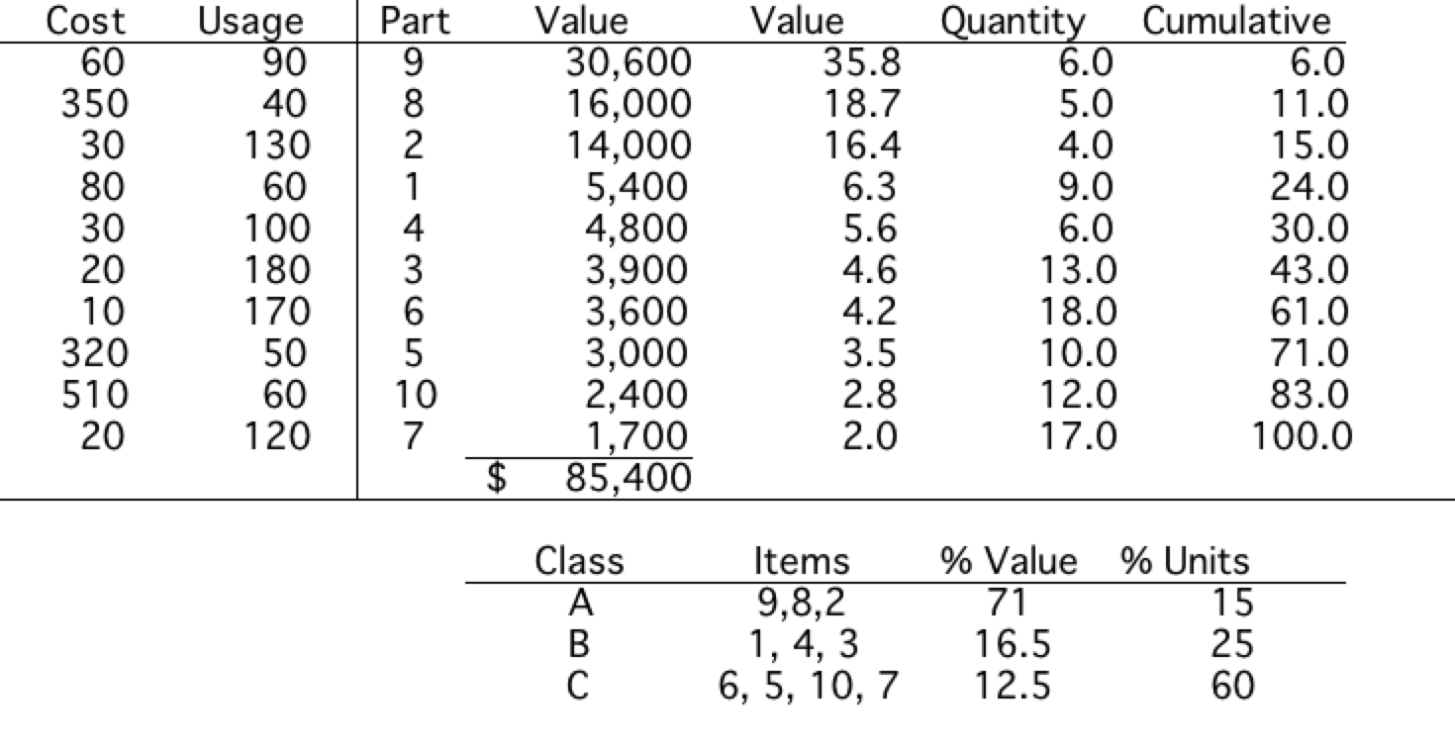
ABC Classification Example

Slide 31
ABC Inventory Control
Control Based on ABC Classification
  Two general rules:
    Have plenty of low-value items - C items are only important if there is a shortage of one of them - then they become extremely important - so a supply should always be on hand.
    Use the money & control effort saved to reduce the inventory of high-value items - A items are extremely important and deserve the tightest control & the most frequently reviewed

Slide 32
ABC Inventory Control
A Items
B Items
C Items
Tight Control
Complete, accurate records
Regular, frequent review by management
Frequent review of forecasts
Close follow-up
Normal Control
Good records
Normal processing
Simplest possible control
Make sure there are plenty
Simple or no records
Large order quantities

