Slide 1
Inputs and Outputs to Aggregate Production Planning
Capacity
Constraints
Strategic
Objectives
Company
Policies
Demand
Forecasts
Financial
Constraints
Aggregate
Production
Planning
Size of
Workforce
Units or dollars
subcontracted,
backordered, or
lost
Production
per month
(in units or $)
Inventory
Levels

Slide 2
Production Activity Control-Scheduling
Specifies when
labor
equipment
facilities
are needed to produce a product or provide a
service
Last stage of planning before production occurs

Slide 3
Scheduling Function By Process Type
Process Industry
linear programming
EOQ with noninstantaneous replenishment
Mass Production
assembly line balancing
Project
project -scheduling techniques (PERT, CPM)

Slide 4
Scheduling Batch/Job Shop Operations
Batch Production
many planning steps
aggregate planning
master scheduling
material requirements planning (MRP)
capacity requirements planning (CRP)
Scheduling determines
machine/worker/job assignments
resource/requirement matchings

Slide 5
Difficulties Of Job Shop Scheduling
Variety of jobs (customers) processed
Distinctive routing and processing requirements of each job/customer
Number of different orders in the facility at any one time
Competition for common resources

Slide 6
This Variety Necessitates
Planning for the production of each job as it arrives
Scheduling its use of limited resources
Monitoring its progress through the system

Slide 7
Objectives in Scheduling
Meet customer due dates
Minimize job lateness
Minimize response time
Minimize completion time
Minimize time in the system
Minimize overtime
Maximize machine or labor utilization
Minimize work-in-process inventory

Slide 8
Responsibilities of Production Control Department
1. Loading - Check availability of material, machines & labor
2. Sequencing - Release work orders to shop & issue dispatch lists for individual machines
3. Monitoring - Maintain progress reports on each job until it is complete

Slide 9
Loading
Allocate work to machines (resources)
Perform work on most efficient resources
Use assignment method of linear programming to determine allocation

Slide 10
Sequencing
Prioritize jobs assigned to a resource
If no order specified use first-come first-served (FCFS)
Many other sequencing rules exist
Each attempts to achieve to an objective

Slide 11
Sequencing Rules
FCFS - first-come, first-served
LCFS - last come, first served
SPT - shortest processing time
DDATE - earliest due date
SLACK - smallest slack
(due date - today’s date) - (remaining processing time)
RWK - remaining work on all operations

Slide 12
Guidelines for Selecting a Sequencing Rule
1. SPT most useful when shop is highly congested
2. Use SLACK or S/OPN for periods of normal activity
3. Use DDATE when only small tardiness values can be tolerated
4. Use LPT if subcontracting is anticipated
5. Use FCFS when operating at low-capacity levels
6. Do not use SPT to sequence jobs that have to be assembled with other jobs at a later date

Slide 13
Monitoring
Gantt Chart
shows both planned and completed activities against a time scale
Input / Output Control
monitors the input and output from each work center

Slide 14
Gantt Chart
Job 32B
Key:
3
Behind schedule
Completed
Activity
Planned
Activity
Job 23C
2
Ahead of schedule
Facility
Job 11C
Job 12A
1
On schedule
1
2
3
4
5
6
8
9
10
11
12
Days

Slide 15
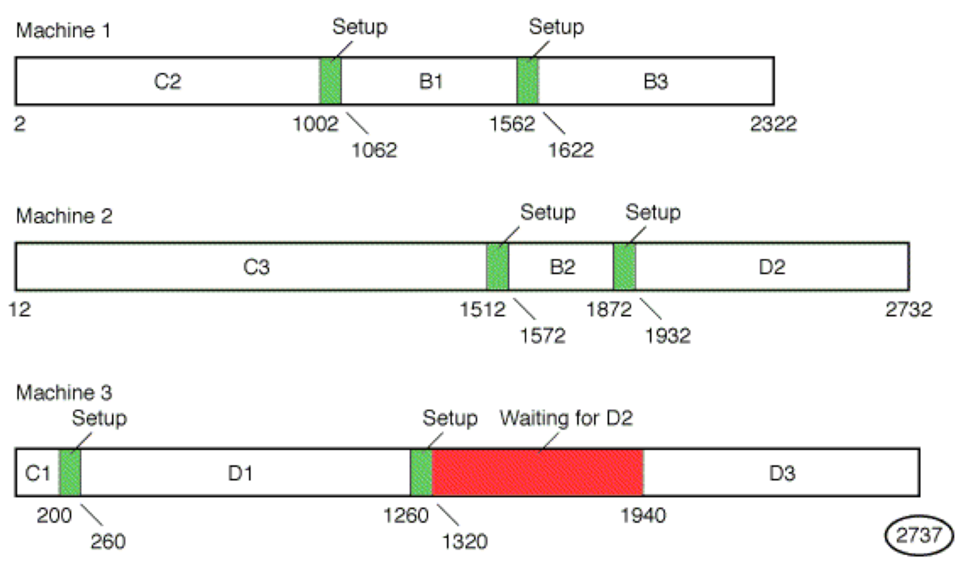
Gantt Chart Solution

Slide 16
Employee Scheduling
Labor is very flexible resource
Scheduling workforce is complicated repetitive task
Assignment method can be used
Heuristics are commonly used
LP is also commonly used

Slide 17
Sequencing Jobs Through Two Serial Process
1. List time required to process each job at each machine. Set up a one-dimensional matrix to represent desired sequence with # of slots equal to # of jobs.
2. Select smallest overall processing time. If that time is on machine 1, put the job as near to beginning of sequence as possible.
3. If smallest time occurs on machine 2, put the job as near to the end of the sequence as possible.
4. Remove job from list.
5. Repeat steps 2-4 until all slots in matrix are filled & all jobs are sequenced.

Slide 18
Johnson’s Rule Example
Machine Machine
Job Center 1 Center 2
A 6 8
B 11 6
C 7 3
D 9 7
E 5 10
E A D B C

Slide 19
Sequencing Jobs Through Many Machines / Processes
Facility is dynamic, new jobs added
Develop global sequencing rules
first-in-system, first-served (FISFS)
work-in-next-queue (WINQ)
fewest # remaining operations (NOPN)
slack per remaining operation (S/OPN)
remaining work (RWK)
Study system via simulation

Slide 20
Sequencing Jobs Through Three Serial Process
1. Apply Johnson’s Rule to the processing times at the first machine and the last machine. Note the sequence of the jobs .
2. Form two new columns. Column 1 is the sum processing times at machine 1 and 2. Column 2 is the sum processing times at machine 2 and 3. Sequence the jobs according to Johnson’s Rule using the processing times from the new columns. Note the sequence of the jobs.
3. Compare the minimum makespan for the solutions obtained in (1) and (2) and chose the sequence giving the shortest makespan.

Slide 21
Johnson’s Rule Example II
Machine Machine Machine
Job Center 1 Center 2 Center 3
A 6 8 12
B 11 6 11
C 7 3 7
D 9 7 21
E 5 10 2

