Slide 1
Materials Management Systems
Introductions and Housekeeping
What is materials management?
Why study materials management?
Manufacturing Strategies
The Supply Chain Perspective
Careers in materials management
Notes:
Thank you.
Purchasing in the year 2000: Only 1.5 years away.

Slide 2
What is Materials Management?
The grouping of management functions supporting the complete cycle of material flow, from the purchase and internal control of production materials to the planning and control of work in process to the warehousing, shipping, and distribution of the finished product.
APICS Dictionary, 8th Edition

Slide 3
Objectives of Materials Management
Maximize the use of the firm’s resources.
Provide the required level of customer service.
Help identify the products and services that can be best obtained externally.
Develop, evaluate, and determine the best supplier, price, and delivery for those products and services.

Slide 4
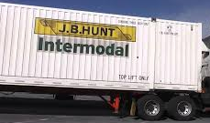
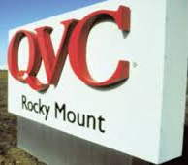
Why study Materials Management? ECU Supply Chain Graduate Employers

Slide 5
Importance of Materials Management
Usually largest component of cost
Often largest component of inventory
Necessary component of best customer service

Slide 6
Percentage of Sales on P/OM Function

Slide 7
Jobs in the U.S.

Slide 8
Make/Buy Considerations
Reasons for Making Reasons for Buying
lower production cost
unsuitable suppliers
assure adequate supply
utilize surplus labor and make a marginal contribution
obtain desired quantity
remove supplier collusion
obtain a unique item that would entail a prohibitive commitment from the supplier
lower acquisition cost
preserve supplier commitment
inadequate capacity
reduce inventory costs
ensure flexibility and alternate source of supply
product improvements may be difficulty because it is a sideline

Slide 9
The Purchasing Focus
Source Management
-Unique items
-Custom-made items
-High technology items
Purchasing Management
-Commodity items
-Standard products
Materials Management
-High transportation cost
-High inventory costs
Supply Management
-High costs
-Scarcity: national or international

Slide 10
Organizational Changes

Slide 11
21st Century Supply Chain Excellence
Responsiveness
Flexibility
Best
Cost
HOW?

Slide 12
21st Century Supply Chain Excellence
Global
Supply
JIT
Leverage
Information Systems
Inventory Management
Logistics

Slide 13
Traditional Material and Order Flow
Raw
Material
Inventory
Suppliers/
Vendors
Incoming
Inspection
Finished Goods
Inventory
Distributors/
Retail
Conversion
D
D
D
Transportation
Quality
Control
Customers
Receiving
Transportation
MRO
Inventory
WIP
Inventory
Work Orders
Orders from
distributors
Purchasing
Production Inventory
Control
Order Entry

Slide 14
Supply Chain Inventory Perspective
Providing Current
Products &
Services
Suppliers
Customers
Raw
FGI
Raw
FGI
Feedback
Feedback

Slide 15
Supply-Production-Distribution System
S
U
P
P
L
I
E
R
Distribution
System
C
U
S
T
O
M
E
R
Manufacturer
Manufacturing
Planning and
Control
Physical
Supply
Physical Distribution
Raw Materials
Processing
Finished Goods
Flow of Demand and Design Information

Slide 16
Wealth Creation
Where does wealth come from?
Natural resources
Services
Manufacturing / production
How can we increase our wealth?
Value-added

Slide 17
What is Value Added?
The actual increase of utility from the viewpoint of the customer as a part is transformed from raw material to finished inventory. It is the contribution made by an operation or a plant to the final usefulness and value of a product, as seen by the customer. The objective is to eliminate all non-value-added activities in producing and providing a good or service.
APICS Dictionary, 8th

Slide 18
Conflicts in Traditional Systems
Four Main Objectives to improve Profits:
Provide best customer service
Provide lowest production costs
Provide lowest inventory investment
Provide lowest distribution costs

Slide 19
Conflicts in Traditional Systems
Is there any conflict in the objectives of best customer service, lowest production costs, and lowest inventory investment? Why?
How can the conflicts be managed?

Slide 20
Conflicts in Traditional Systems
Marketing
Maintain high inventories
Interrupt production runs
Create extensive and costly distribution system
Finance
Reduce inventory
Decrease plants and warehouses
Use long production runs
Manufacture to customer order
Production
Make long production runs
Maintain high inventories of raw materials and WIP

Slide 21
Objectives of Materials Management
Maximize use of the firm’s resources
Manufacturing Planning and Control
Provide required level of customer service
Customer service means being able to provide the customer the right quality, quantity, time, place, price

Slide 22
Manufacturing Planning & Control
Production Planning
Forecasting
Master Planning
MRP
Capacity Planning
Implementation & Control
Inventory Management

Slide 23
Manufacturing and Control System
5 Inputs
Bill of Material
Describes components used to make the product
Describes subassemblies at various stages
Process Specifications
Operations & Sequence required to make the product
Equipment and accessories required
Standard time required to perform each operation
Time needed to perform operations
Available facilities
Quantities required

Slide 24
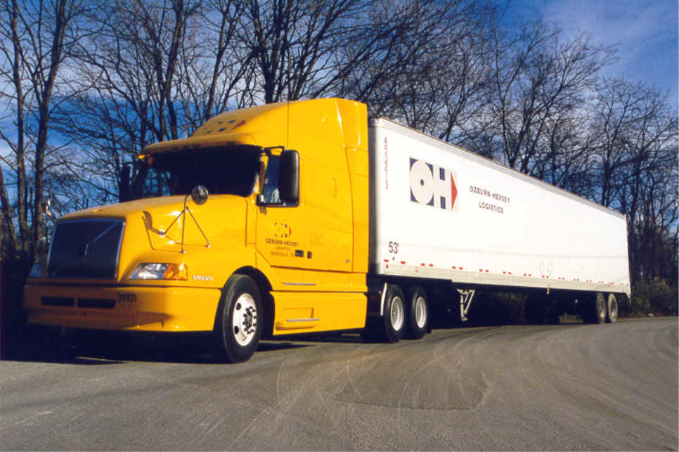
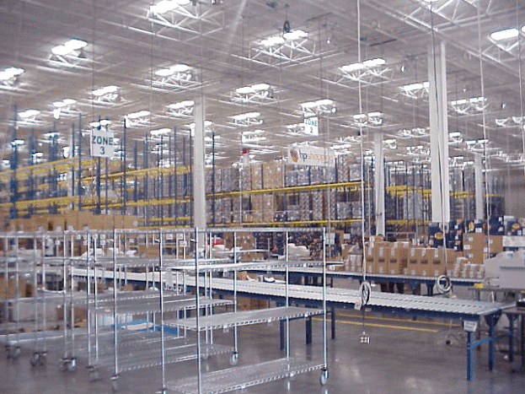
Physical Supply/Distribution
• Activities include
- Transportation
- Distribution Inventory
- Warehousing
- Packaging
- Materials Handling
- Order Entry

Slide 25
Entry Careers in Mat’ls Mgt.
Production / inventory control (schedulers, expeditors, mat’ls analysts)
Info. system development
Purchasing (expeditors, asst. buyers)
Quality management (inspectors, quality system coordinators)

