Slide 1
Physical Distribution Definition
Physical distribution is the movement & storage of finished goods from the end of production to the customer
One person’s distribution is another person’s supply

Slide 2
Supply Chain (Logistics System)
SUPPLIERS
CU
S
TOMER
DISTRIBUTION
SYSTEM
MANUFACTURER
Physical
Supply
Manufacturing
Planning and
Control
Physical Distribution
DOMINANT FLOW OF PRODUCTS AND SERVICES
DOMINANT FLOW OF DEMAND & DESIGN INFORMATION

Slide 3
Activities in Physical Distribution
Transportation: Accounts for 30-60% of dist. Costs, adds place value
Distribution Inventory: Accounts for 25-30% of cost, adds time value
Warehouses (distribution centers): Store inventory
Materials Handling: Moves goods
Protective Packaging
Order Processing & Communication

Slide 4
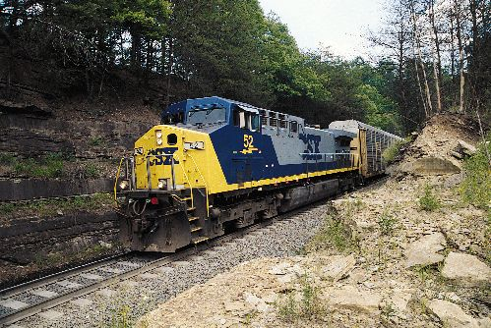
5 Modes of Transportation Rail
Large fixed investment, good for bulky commodities over great distance

Slide 5
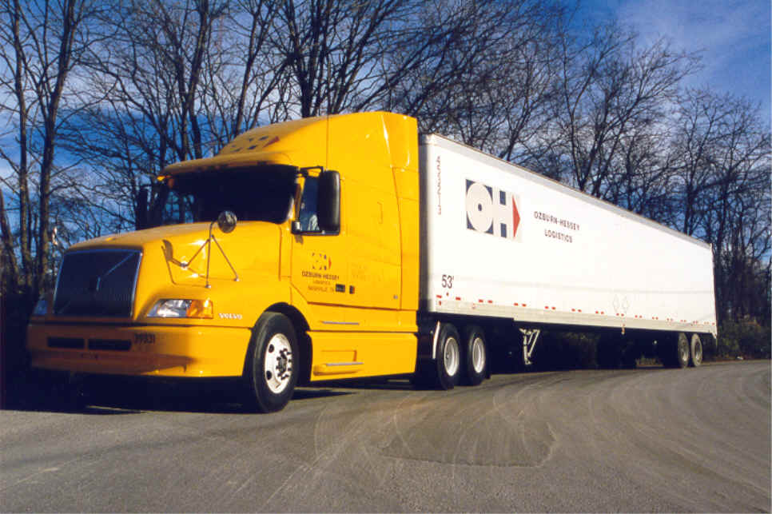
5 Modes of Transportation Road
Relatively small investment, fast, flexible service for small cargoes

Slide 6
5 Modes of Transportation Air
High capital costs, high variable costs, high speed of service & flexibility

Slide 7
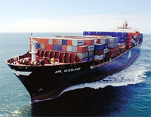
5 Modes of Transportation Water
Low costs, fixed costs absorbed over large volumes

Slide 8
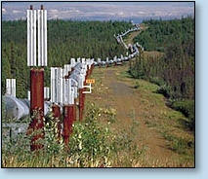
5 Modes of Transportation Pipeline
High capital / low operating costs
Very high volume
Obviously for viscous products

Slide 9
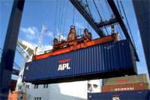
5 Modes of Transportation Multi-Modal
Ship – Rail – Truck
Ship – Truck
Rail – Truck
Air – Truck
Pipeline – Truck

Slide 10
5 Modes of Transportation
Each of these 5 modes of transportation have:
WAYS
TERMINALS
VEHICLES (except pipelines).

Slide 11
Logistics Information Systems
Location
Loading
Routing
Schedule
Volume

Slide 12
Transportation Cost Elements
Line-haul
Pickup & delivery
Terminal handling
Billing & collecting

Slide 13
Shipping Patterns
Number of customers
Geographic distribution of customers
Customer order size
Number & location of plants & distribution centers

Slide 14
Roles of Packaging
Identify the product
Contain and protect the product
Contribute to physical distribution efficiency
In many applications, the environmental impact of packaging is significant.

